Slide 1


EMS Grand Rounds January 2016

Slide 2
Less is More
Permissive Hypotension and TXA in Hemorrhagic Trauma

Slide 3
Jim Cole, LP, FP-C
EMS and Emergency Management Coordinator
PeaceHealth Oregon Network
jcole3@peacehealth.org

Slide 4
Lee Weickum, RN
Regional Clinical Manager – Oregon
REACH Air Medical Services
Lee.Weickum@reachair.com

Slide 5
Goals
Review current prehospital education and guidelines
Discuss relevant science for permissive hypotension and use of Tranexamic Acid
Present Best Practice in use of permissive hypotension, Tranexamic acid administration, and liberal use of tourniquets and hemostatic gauze

Slide 6
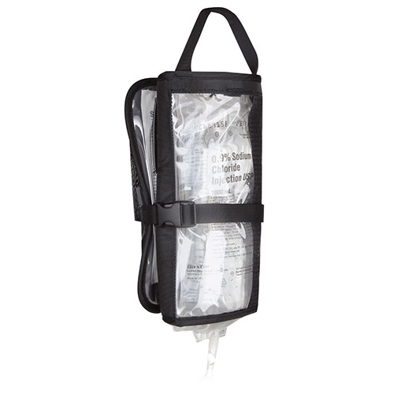
Current practices
Control of bleeding through use of direct pressure, pressure points and occasional use of tourniquets.
Two peripheral large bore IVs wide open fluid resuscitation using normal saline (NS) or lactated ringer’s (LR) solutions.
Maintenance of “normotensive blood pressures” generally above 100 systolic.

Slide 7
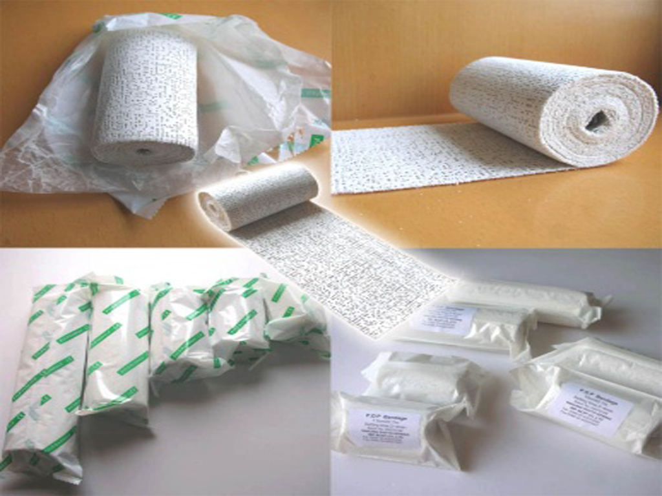
Current practices
Limited use of hemostatic non-exothermic compresses and or powders.
No internal bleeding control mechanisms such as clamping.
No use of colloidal agents such as FFP, Blood and or blood products.
No use of antifibrinolytic medications such as tranexamic acid.

Slide 8
Critical Care Medicine. 2000 Mar;28(3):749-54.
Vigorous infusion of normal saline after massive splenic injury resulted in a significant increase in intra-abdominal bleeding and decreased survival time. The hemodynamic response to crystalloid infusion in blunt abdominal trauma is primarily dependent on the severity of injury and the rate of blood loss.

Slide 9
J.R.Coll.Surg.Edinb. 2002 April;47:2, 451-457
Cannulation should take place en route, where possible
Only two attempts at cannulation should be made
Transfer should not be delayed by attempts to obtain intravenous access
Entrapped patients require cannulation at the scene
Normal saline is recommended as a suitable fluid for administration to trauma patients
Boluses of 250 ml fluid may be titrated against the presence or absence of a radial pulse (caveats; penetrating torso injury, head injury, infants)

Slide 10
J Trauma. 2011 Mar;70(3):652-63.
Hypotensive resuscitation is a safe strategy for use in the trauma population and results in a significant reduction in blood product transfusions and overall IV fluid administration. Specifically, resuscitating patients with the intent of maintaining a target minimum MAP of 50 mm Hg, rather than 65 mm Hg, significantly decreases postoperative coagulopathy and lowers the risk of early postoperative death and coagulopathy. These preliminary results provide convincing evidence that support the continued investigation and use of hypotensive resuscitation in the trauma setting.

Slide 11
2013 American Association of Critical-Care Nurses
Life-threatening hemorrhage, however, can also be managed by maintaining a state of permissive hypotension(systolic blood pressure <80 mm Hg) while the patient is transferred from the accident site to the operating room. Evidence indicates that the hypotensive state may be more beneficial to patients, by limiting coagulopathy and hypothermia.

Slide 12
Tranexamic Acid
An Old Dog With New Tricks
Jeff Cress LP, CCEMT-P
Program Manager
Santa Rosa, Lakeport, and Willits
California

Slide 13
How Does Bleeding Stop?
Three processes occur to stop bleeding:
  Vasoconstriction
  Platelet Adhesion
  Fibrin Clot

Slide 14
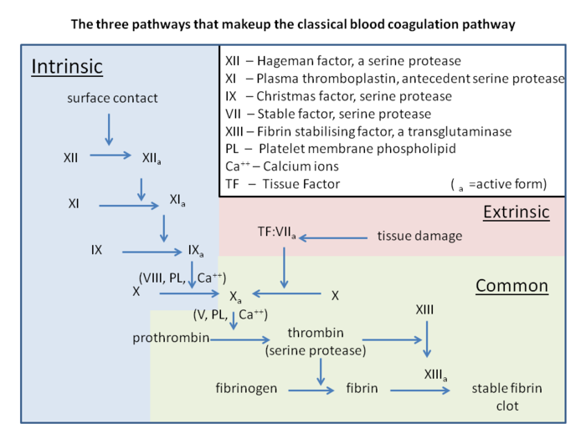

Slide 15
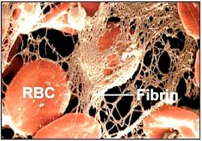
Fibrin Clot
Image from www.daviddarling.info

Slide 16
What is Tranexamic Acid?
TXA was created in the 1950’s in Japan by scientists Shosuke and Utako Okamoto.
TXA is a synthetic derivative of the amino acid lysine.
TXA is an anti-fibrinolytic that competitively inhibits the activation of plasminogen to plasmin. Plasmin breaks down fibrin.
TXA may reduce the pro-inflammatory effects of plasmin.

Slide 17
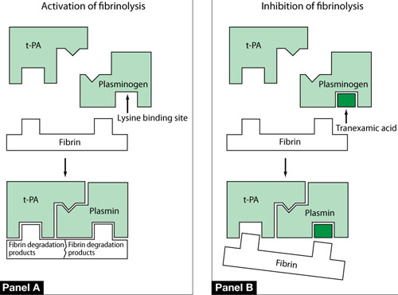
Image from www.obgmanagement.com, Oct. 2010 – Vol. 22, No. 10

Slide 18
Some Uses for TXA
Bleeding during surgery
  Heart, liver, vascular, orthopedic, pediatric, eye
Dental work – 5% TXA mouth wash
Non-hereditary angioedema
Menorrhagia – available as prescription since 1972
Acquired and inherited bleeding disorders
Epistaxis
Topical application for external bleeding

Slide 19
TXA in Elective Surgery
TXA in elective surgical patients has shown to:
  Reduce number patients receiving transfusion by ~1/3
  Reduce volume of blood transfused by 1 unit
  Decrease the need for further surgery to control bleeding by 50%
These results helped lead to the CRASH 2 study.

Slide 20

http://www.crash2.lshtm.ac.uk/

Slide 21
Millions bleed to death after trauma each year
There are millions of trauma deaths each year. Many patients survive to reach hospital. This slide shows the causes of in-hospital trauma deaths
Bleeding
45%
CNS injury
41%
Other
4%
Organ failure
10%

Slide 22
Methods
Over 20,000 bleeding trauma patients were randomly allocated to get tranexamic acid or matching placebo
Included all adult trauma patients who were within 8 hours of their injury, if their doctor thought that they had or could have significant hemorrhage
Collected data on death in hospital within
4 weeks of injury and all important side effects

Slide 23
Trial Dose of Tranexamic Acid
Treatment | Tranexamic acid dose
Loading | 1 gram over 10 minutes (by slow intravenous injection or an isotonic intravenous infusion)
Maintenance | 1 gram over 8 hours (in an isotonic intravenous infusion)

Slide 24





















Randomised many trauma patients
from 274 hospitals
20,211 patients
Patient enrollment
in 40 countries

Slide 25
CRASH-2: excellent follow up
20,211 randomised
10,096 allocated TXA
10,115 allocated placebo
3 consent withdrawn
1 consent withdrawn
10,093 baseline data
10,114 baseline data
33 lost
to follow-up
47 lost
to follow-up
Followed up = 10,060 (99.7%)
Followed up = 10,067 (99.5%)

Slide 26
This is what was found
Cause of death TXA Placebo Risk of death P value
10,060 10,067
Bleeding 489 574 0.85 (0.76–0.96) 0.0077
Thrombosis 33 48 0.69 (0.44–1.07) 0.096
Organ failure 209 233 0.90 (0.75–1.08) 0.25
Head injury 603 621 0.97 (0.87–1.08) 0.60
Other 129 137 0.94 (0.74–1.20) 0.63
Any Death 1463 1613 0.91 (0.85–0·97) 0·0035

Slide 27
Most of the benefit is for bleeding deaths
TXA (n= 10,060)
489 (4.9%)
Placebo (n= 10,067)
574 (5.7%)
RR (95% CI)
0.85 (0.76–0.96) 2P=0.0077
0.8
0.9
1.0
1.1
TXA better
TXA worse
Notes:
This is just reiterating the main effect on all cause mortality.
The bottom line is that this is very good news for trauma patients.
The vertical line crossing 1 signifies the line of no-effect.

Slide 28
For bleeding deaths – early treatment is better
RR (99% CI)
p=0.000008
≤1 hour
0.68 (0.54–0.86)
>1 to ≤ 3 hours
0.79 (0.60–1.04)
>3 hours
1.44 (1.04–1.99)
0.85 (0.76–0.96)
.7
.8
.9
1
1.1
1.2
1.3
1.4
1.5

Slide 29
Treatment must be given early because bleeding deaths happen soon after injury

Slide 30
There was no increase in thrombosis
TXA
allocated
(10,060)
Placebo
allocated
(10,067)
Risk ratio (95% CI)
DVT 40 (0.40%) 41 (0.41%)
PE 72 (0.69%) 71 (0.70%)
MI 35 (0.35%) 55 (0.52%)
Stroke 57 (0.56%) 66 (0.65%)
Any 168 (1.63%) 201 (1.95%)
.6
.7
.8
.9
1
1.1
1.2
TXA better
TXA worse

Slide 31
CRASH-2 Follow-Up Paper: Early Coagulopathy in Trauma
Further Review of Data Showed…
  Acute severe trauma is associated with increased fibrinolysis, leading to early coagulopathy and increased mortality.
  The earlier TXA is given the better, preferably within 3 hours of injury.
  TXA given <1 hr of injury had greatest benefit – 32% reduction in deaths caused by bleeding (5.3% vs 7.7%)
  TXA after 3 hr of injury associated with increased risk of death caused by bleeding (4.4% vs 3.1%): DIC?

Slide 32
Conclusion
Tranexamic acid…
  Shown to reduce mortality in bleeding trauma patients
  Needs to be given within 3 hr of injury; most benefit within 1st hour
  Easy to administer - Same dose for 12 yrs and older
  Is cheap - One dose of TXA ~$40 - $65
  Is being used in military and civilian mass transfusion protocols
  Added to the WHO List of Essential Medicines
  Approved by Jehovah’s Witnesses for use

Slide 33
Best Practices by prehospital level
The guidelines below obviously do not reflect the uniqueness and varying capabilities of different agencies and systems; they will therefore need to be adapted to your individual system’s needs and capabilities.
Each subsequent level of licensure capability adds to all previous level’s recommendations and build upon each other. (i.e. EMR/EMT guidelines should be followed before Advanced EMT guidelines are applied.
Should you need assistance with implementation of these guidelines in the form of draft protocols or suggestions on equipment use, please contact us for assistance.

Slide 34
EMR/EMT
Assess and support ABC’s: Hypotension identified (defined as SBP < 90 and/or HR >110 with suspected hemorrhage from trauma.
CONTROL HEMMORHAGE!
Activate Full Trauma Alert and rapid transport to closest appropriate trauma center for stabilization.
Tag and assign Trauma Band to patient
Discuss issues related to trauma if suspected TBI is present.
Position supine
Keep pt. NPO
Administer supplemental oxygen as needed to maintain SPO2 above 94%
Identify if external source of blood loss (open wound)
  If open wound, apply pressure – consider combat gauze dressing at the wound site and to pack a deep wound where gauze would be able to be extracted. Use hemostatic agent gauze if available.
If wound on extremity bleeds despite direct pressure and pressure dressings, immediately place tourniquet(s) proximal to wound.

Slide 35
Advanced EMT
Start two (2) 14 gauge (or largest possible) peripheral IV
  Do not administer IV fluids unless SBP is below 90.
If shock from suspected blood loss due to trauma is suspected with continued SBP<90, then give bolus of up to 500 mL (or 20 mL/kg for peds) crystalloid until SBP is 90. Cautiously monitor SBP to be sure to not over-infuse crystalloids. May repeat once if needed. (Consider contacting medical control.)
  If suspected traumatic brain injury, then maintain SBP at 100.
  Monitor CBG for diabetic patients if extensive crystalloids are infused.
Continuous monitoring of Vital Signs
Thoroughly document incident, treatments and timing of all interventions.

Slide 36
Oregon Intermediate EMT
If peripheral IV is unsuccessful, place IO in unaffected limb and humeral I/O if bleeding is suspected at or below the pelvis.
Cardiac monitoring/prefer 12-lead
Evaluate and treat dysrhythmias

Slide 37
Paramedic
Consider tension pneumothorax
Best if administered in FIRST hour. CONTRAINDICATED after 3 hours.
Infuse 1GM TXA in 100 mL NS over 10 minutes if any of the following are present:
  Penetrating wound
  Wound that is actively bleeding despite direct pressure
  Blunt thoracic wound with suspected internal bleeding
Extremity wound that requires tourniquet application

Slide 38
TXA Indications
  Suspected hemorrhagic shock in a trauma patient with mechanism AND
  Systolic BP < 90mmHg AND
  Injury occurred less than 3 hours.

Slide 39
TXA Contraindications
  Pediatric patients less than 12 years old.
  Time since injury exceeds 3 hours.
  Isolated Traumatic Brain injury.
  Patients with known, active intravascular clotting (DVT or PE).
  Hypotension and/or shock due to non-hemorrhagic, non-traumatic causes

Slide 40
TXA Procedure
  TXA Bolus (IV/IO): Mix 1 gram in 100ml of NS and infuse over 10 minutes before other IV fluids if possible.
  Best if administered in FIRST hour. CONTRAINDICATED after 3 hours.
  Document any noted side effects
  Document time, dose, amount of medication, route of administration and indication for use
  Document any change in patient physical assessment, clinical presentation and vital signs.

Slide 41
Questions?

Slide 42
Stay online.
Wait for pop up of 10 pt quiz
If no pop up… a follow up email comes in an hour.

Slide 43
Thanks for attending
Less is More
Permissive Hypotension and TXA in Hemorrhagic Trauma

