Slide 1
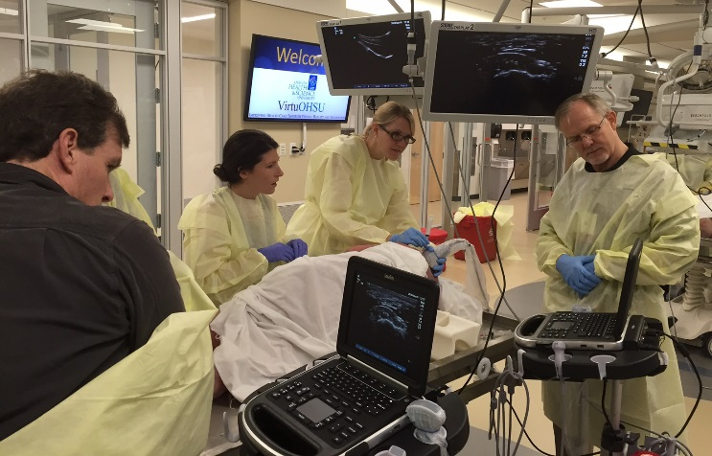

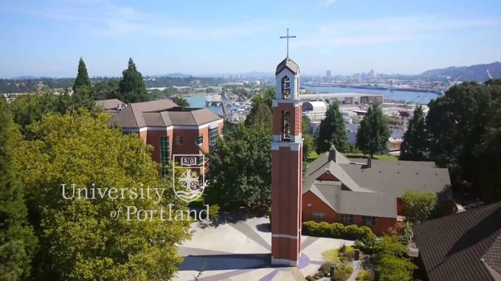
Southwest Washington
Sports Medicine Fellowship
Kevin deWeber, MD, FAMSSM, FAAFP, FACSM, RMSKS
Program Director

Slide 2
Overview
PeaceHealth
Residency
Fellowship
  Faculty
  Training sites
  Schedule template
  Salary and Benefits

Slide 3
PeaceHealth is a not-for-profit health care system with medical centers, critical access hospitals, medical clinics and laboratories located in Alaska, Oregon and Washington.

Slide 4
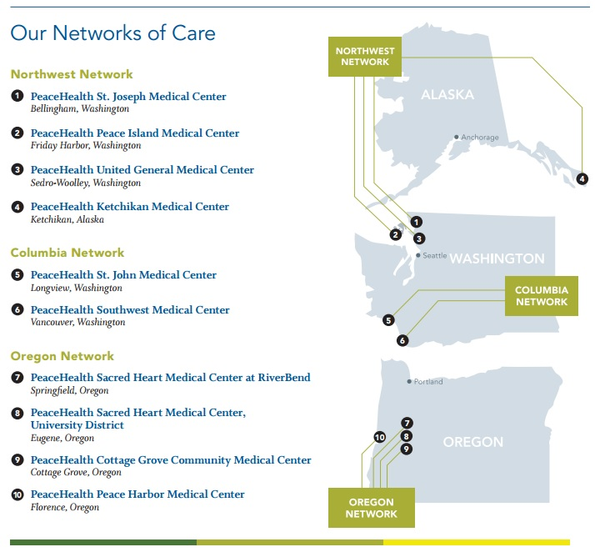
PeaceHealth Networks

Slide 5
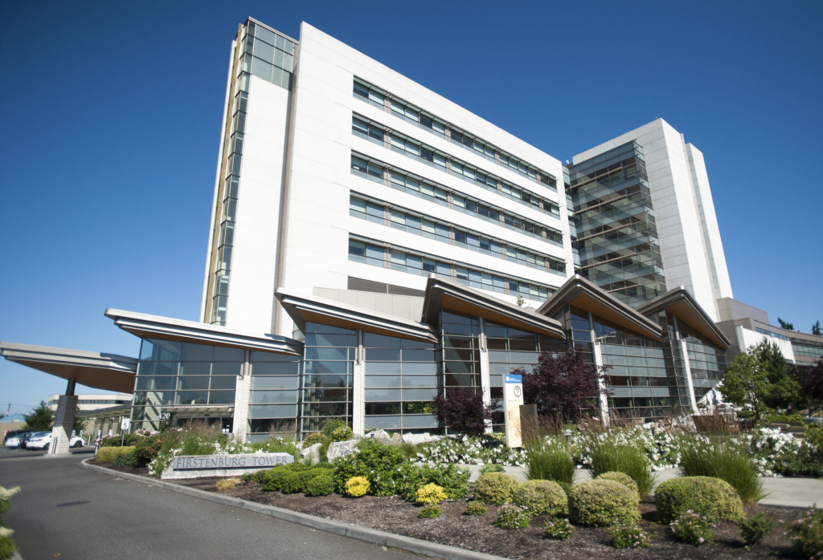
Southwest Medical Center
Note: fellows do not provide inpatient or labor/deliver care during training
Notes:
450 beds and Level II trauma center. Rebound Orthpedics’ main office is located in the Physicians Pavion. Fellows do not provide inpatient or labor & delivery care during their training.

Slide 6
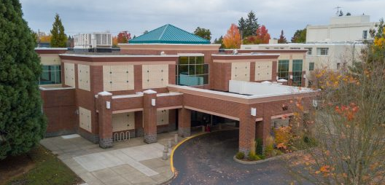
Family Medicine of SW Washington
Residency & Fellowship Clinic
24 faculty
24 residents
1 fellow
Specialties:
  Sports Med, Physical Therapy, OMT
  Integrative Med
  Ob/Gyn
  HIV, Addiction Med
  Pharmacology
  Behavioral Health

Slide 7
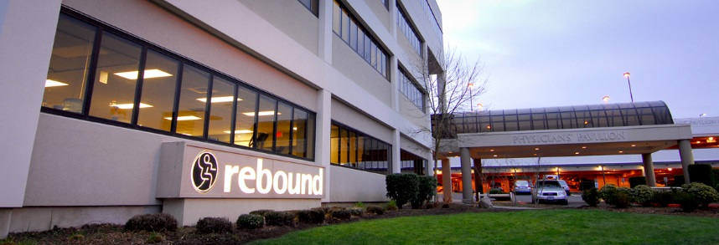
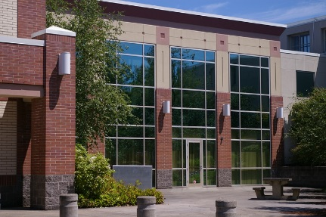



Fellowship Training Sites
Primary Care Sports Med:
  4 hd/wk
FM Clinic
  2 hd/wk
Orthopedics:
  1-2 hd/wk
Team Physician:
  2-3 TR clinics/wk + games
Didactics & Ultrasound
  1 hd/wk

Slide 8
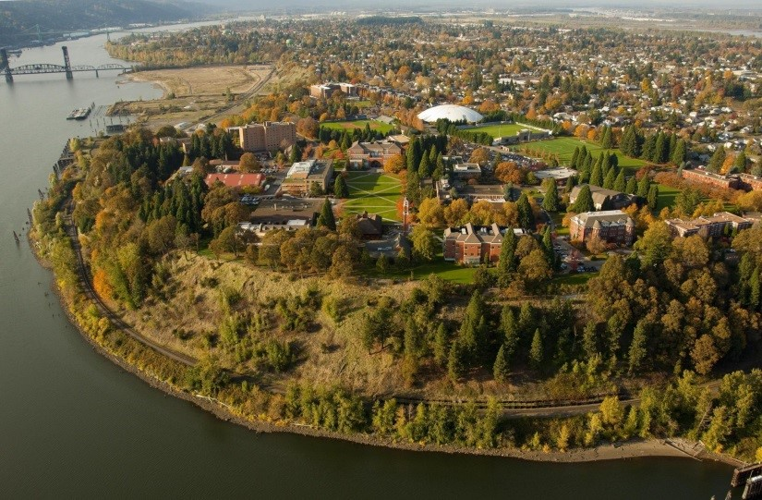

University of Portland
Team Physician experience, Div 1A
275-300 athletes
Sports:
  Soccer
  VB
  Basketball
  Baseball
  XC, T&F
  Tennis
  Rowing

Slide 9



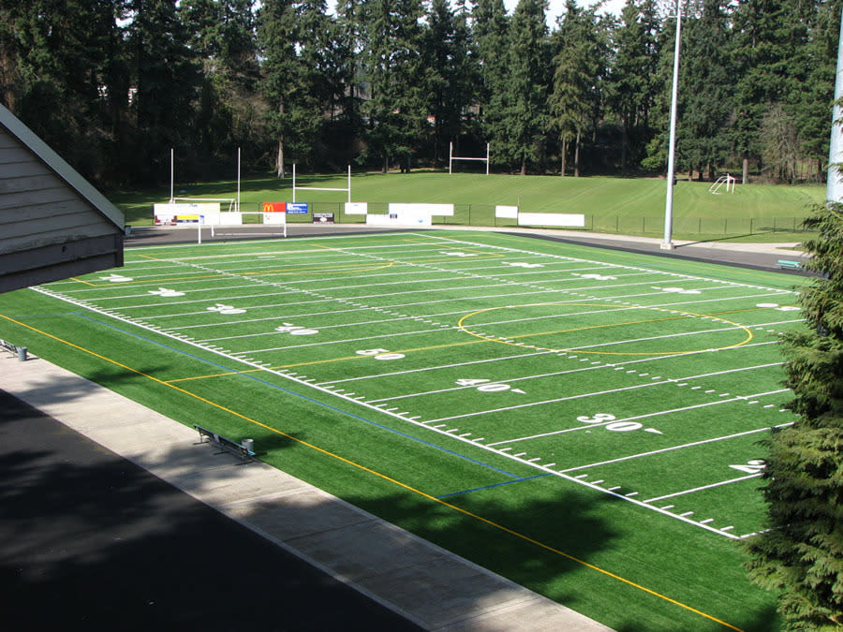
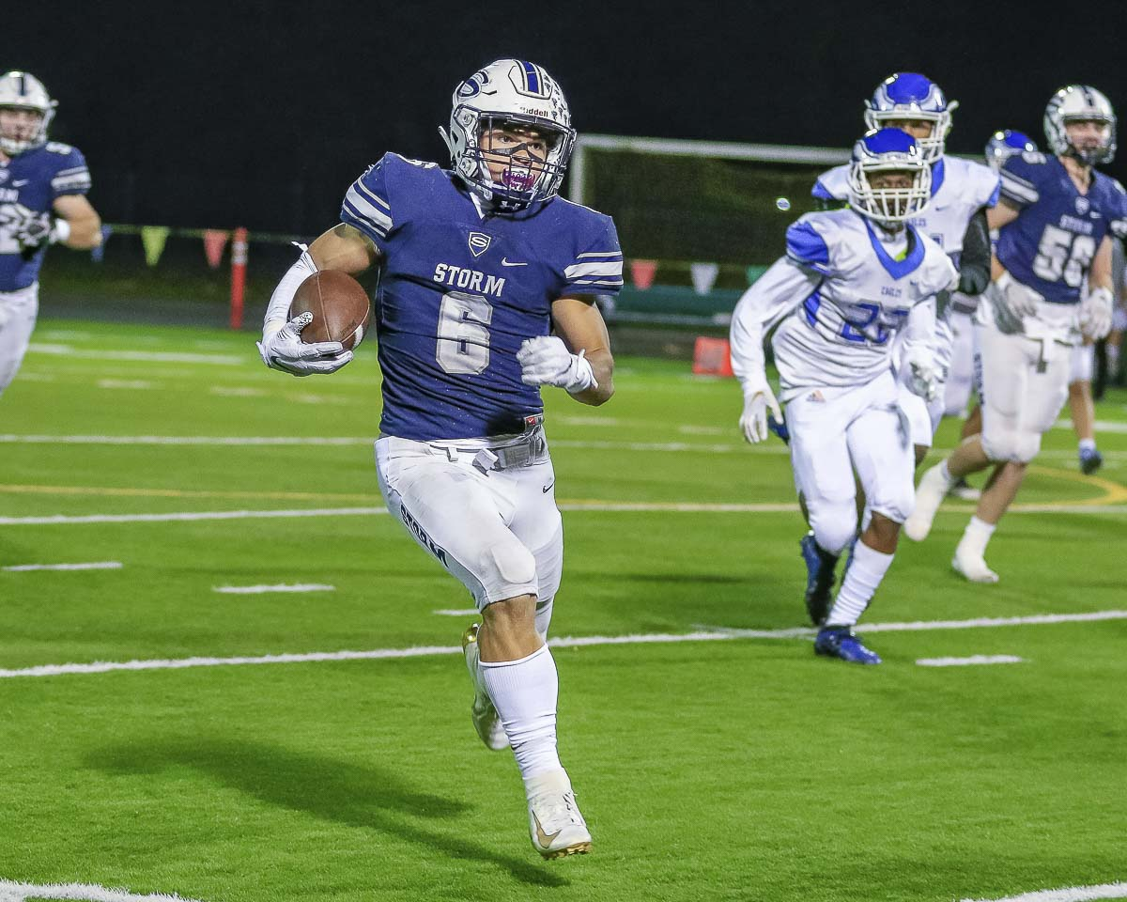
High School Football

Slide 10
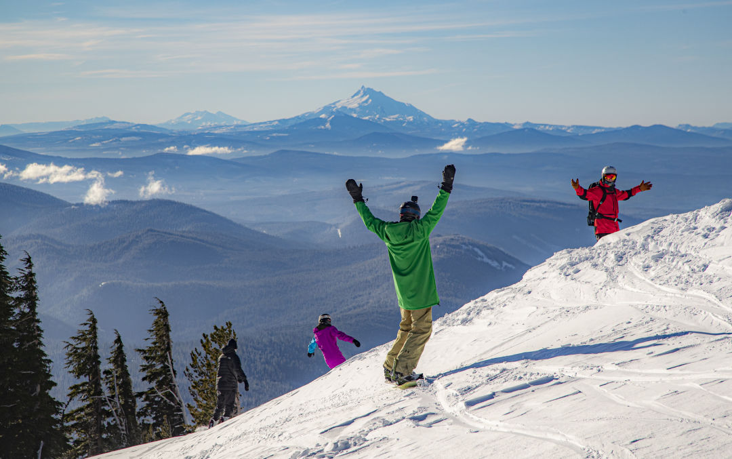
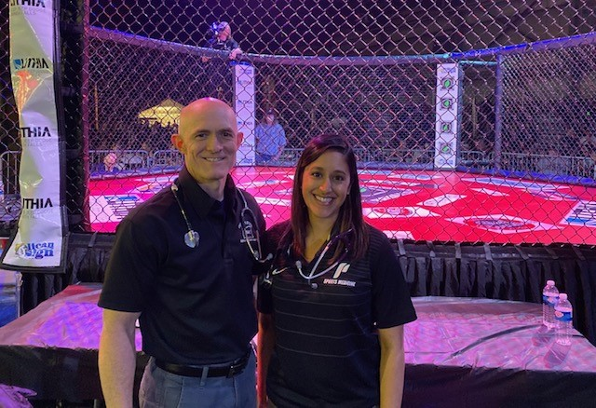
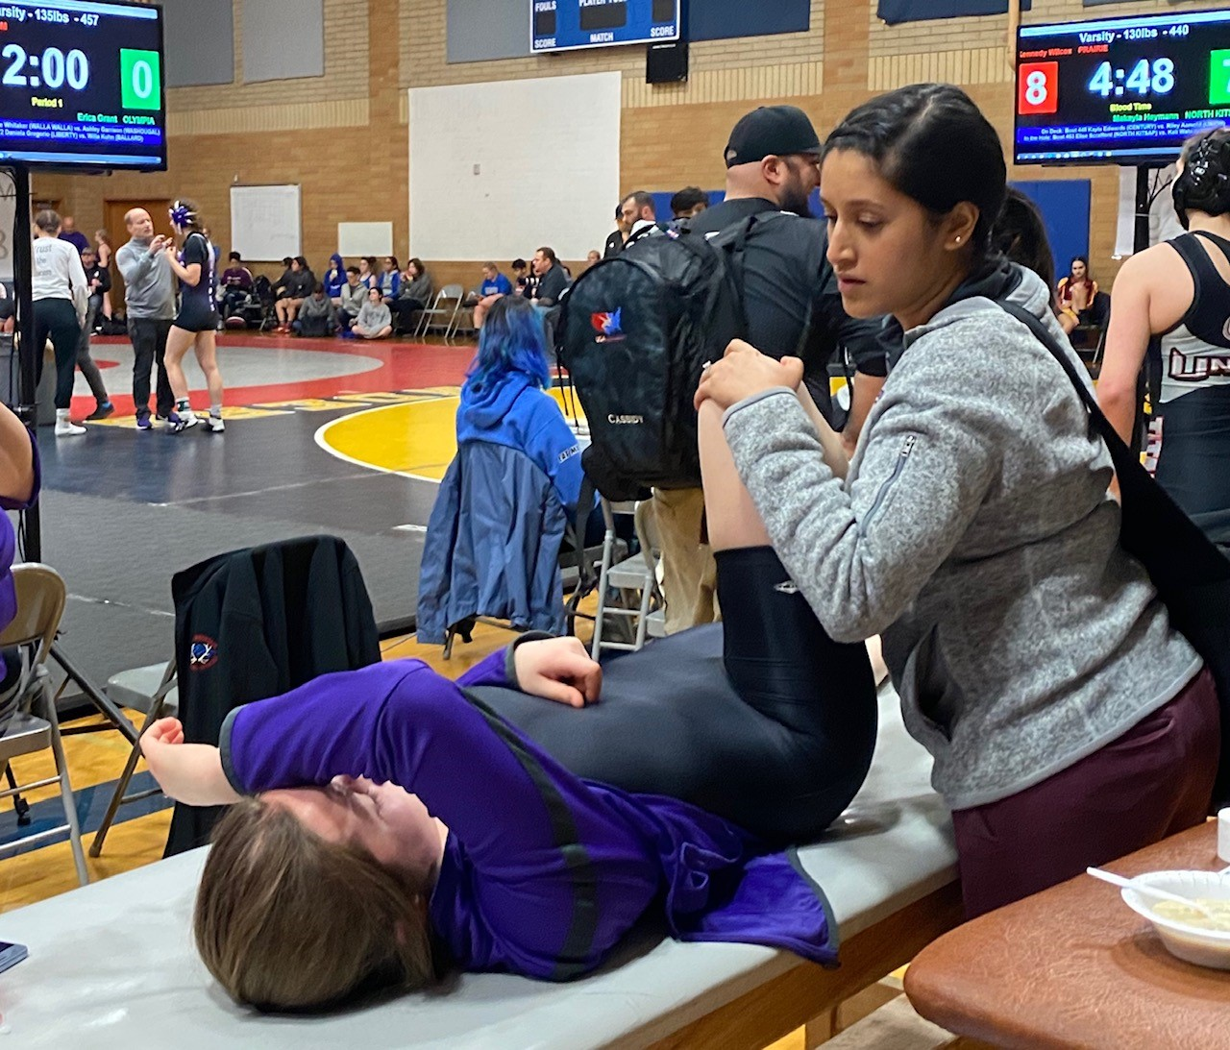
Other event coverage
Mass participation races
Wrestling tournaments
MMA and boxing
Mt. Hood Ski Clinic

Slide 11
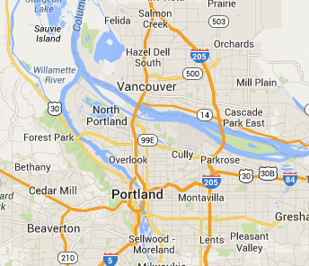
Where is all that?
80%
10%
10%
U of P
OHSU

Slide 12
Family Medicine Clinic
2 hd/wk at FMSW
  No patients empaneled
  May include OMT clinic for DO’s

Slide 13
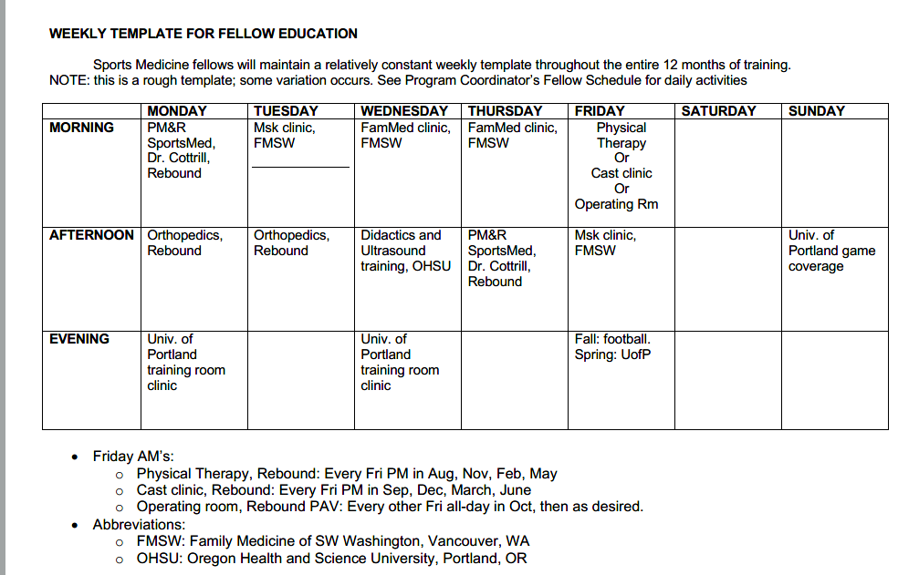
Weekly Template

Slide 14
Procedural Training
Diagnostic US
Interventional US
Landmark-guided procedures
Tenotomy
  Dextrose
  Blood
  PRP
Bone marrow aspirates and mesenchymal stem cells
Hydrodissection
Auricular acupuncture for pain
ECG in athletes

Slide 15
Procedure numbers
(averages, last 7 fellows)
US-guided injections: 188/year
Diagnostic US: 175/year
Landmark-guided injections: 104/year
USGI + DxUS = 363/year
  RMSKS® Benchmark: 150

Slide 16
Teaching Opp’s for Fellows
Mentoring residents at sports events
Resident cast/splint workshop
Resident US workshops
Fellowship didactic lectures
Cadaver injection labs
And…

Slide 17
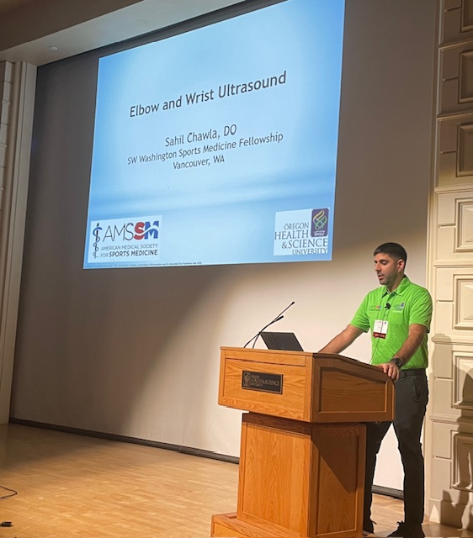
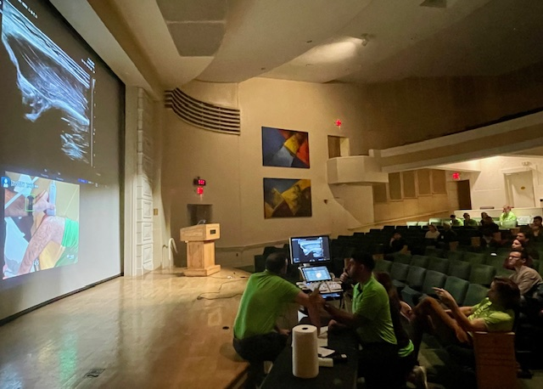
Teach Intro US at AMSSM/OHSU course

Slide 18
Key Faculty

Slide 19

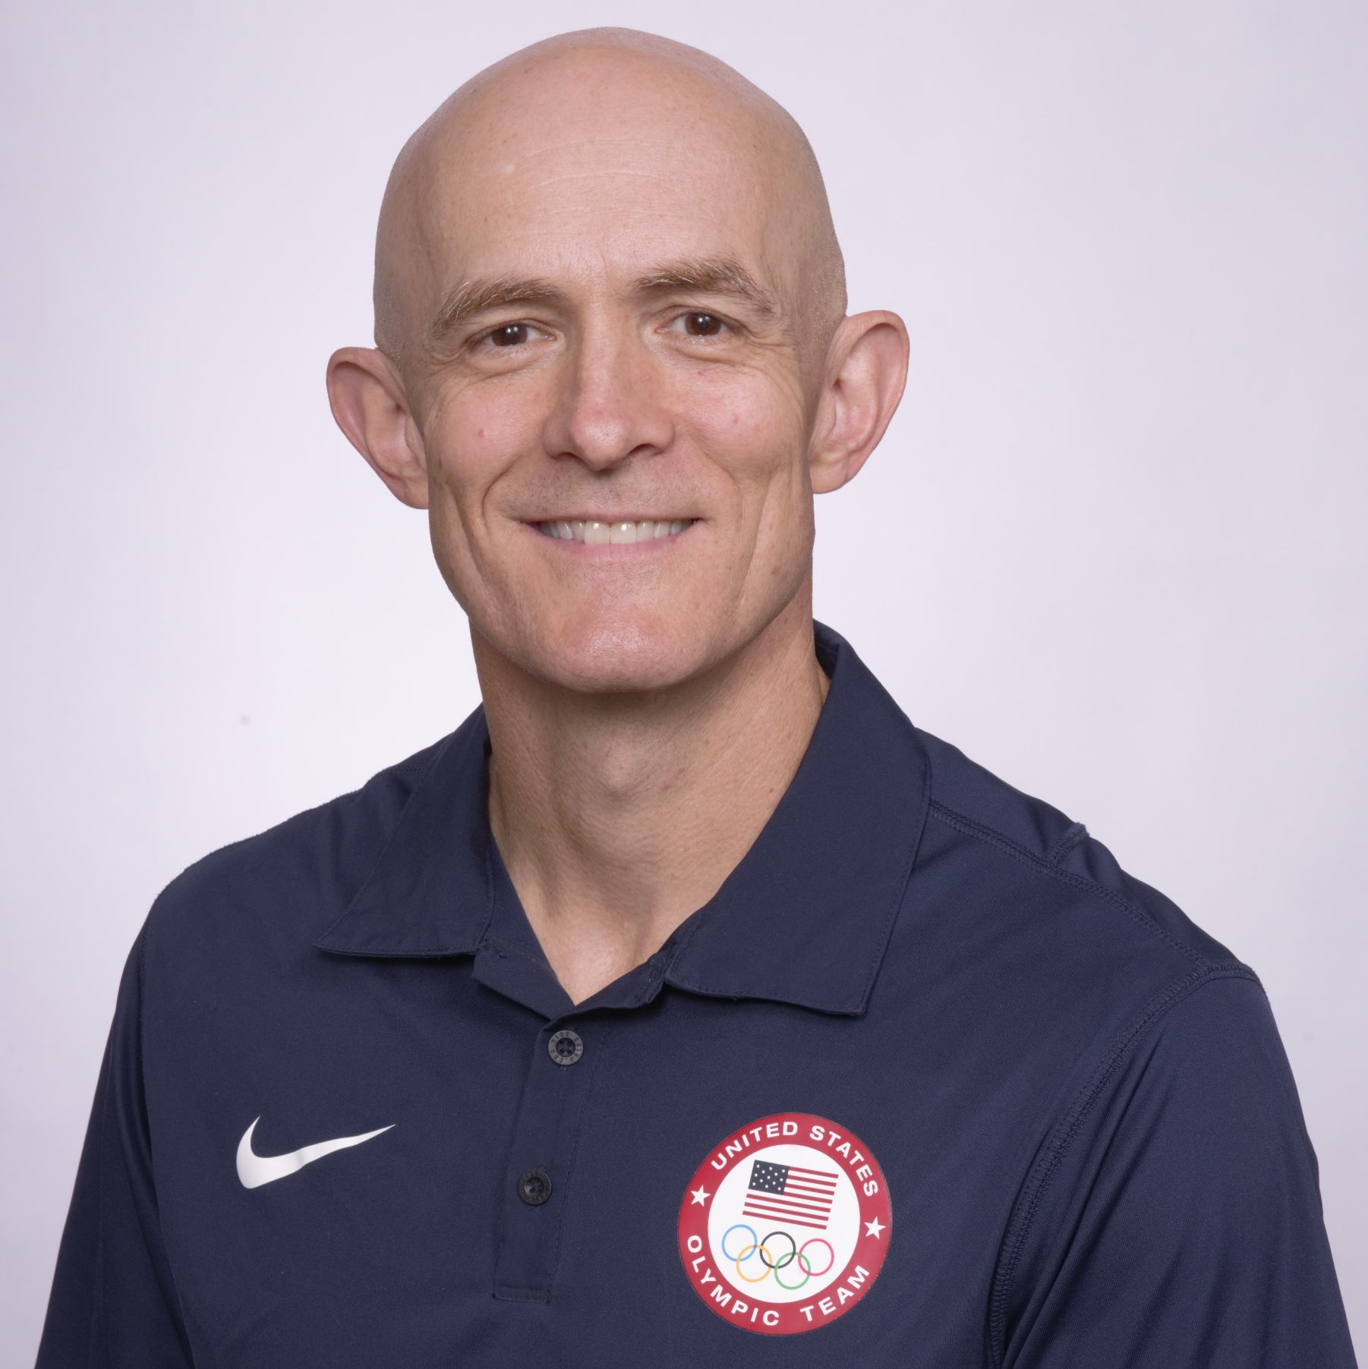

Kevin deWeber, MD, FAMSSM, FAAFP, FACSM, RMSKS
Prior Military Fellowship Director 6 years
  24 graduates, 2007-13
SW Wash. Program Director/founder 2015
Teaching US since 2008
  AMSSM West Coast US course director
US Olympic Medical Team 2012 & 2016

Slide 20
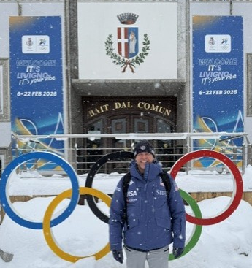


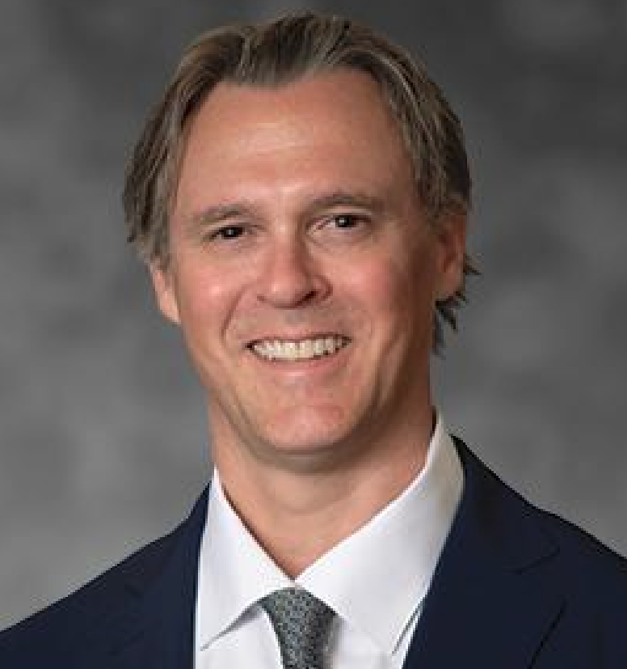
Jerod Cotrill, DO, RMSKS
PM&R and Sports Med
USA Ski Team physician
  2026 Torino Olympics
Former Team Physician, Portland Trailblazers

Slide 21

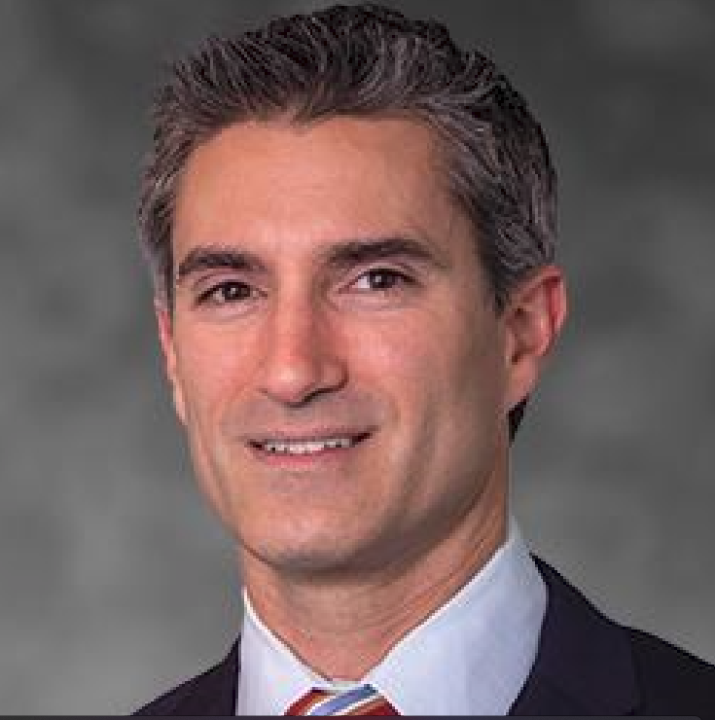
Jerome DaSilva, MD, FRCSC
Orthopedic Sports Medicine
Rebound Orthopedics
Team Physician, Portland Winterhawks

Slide 22
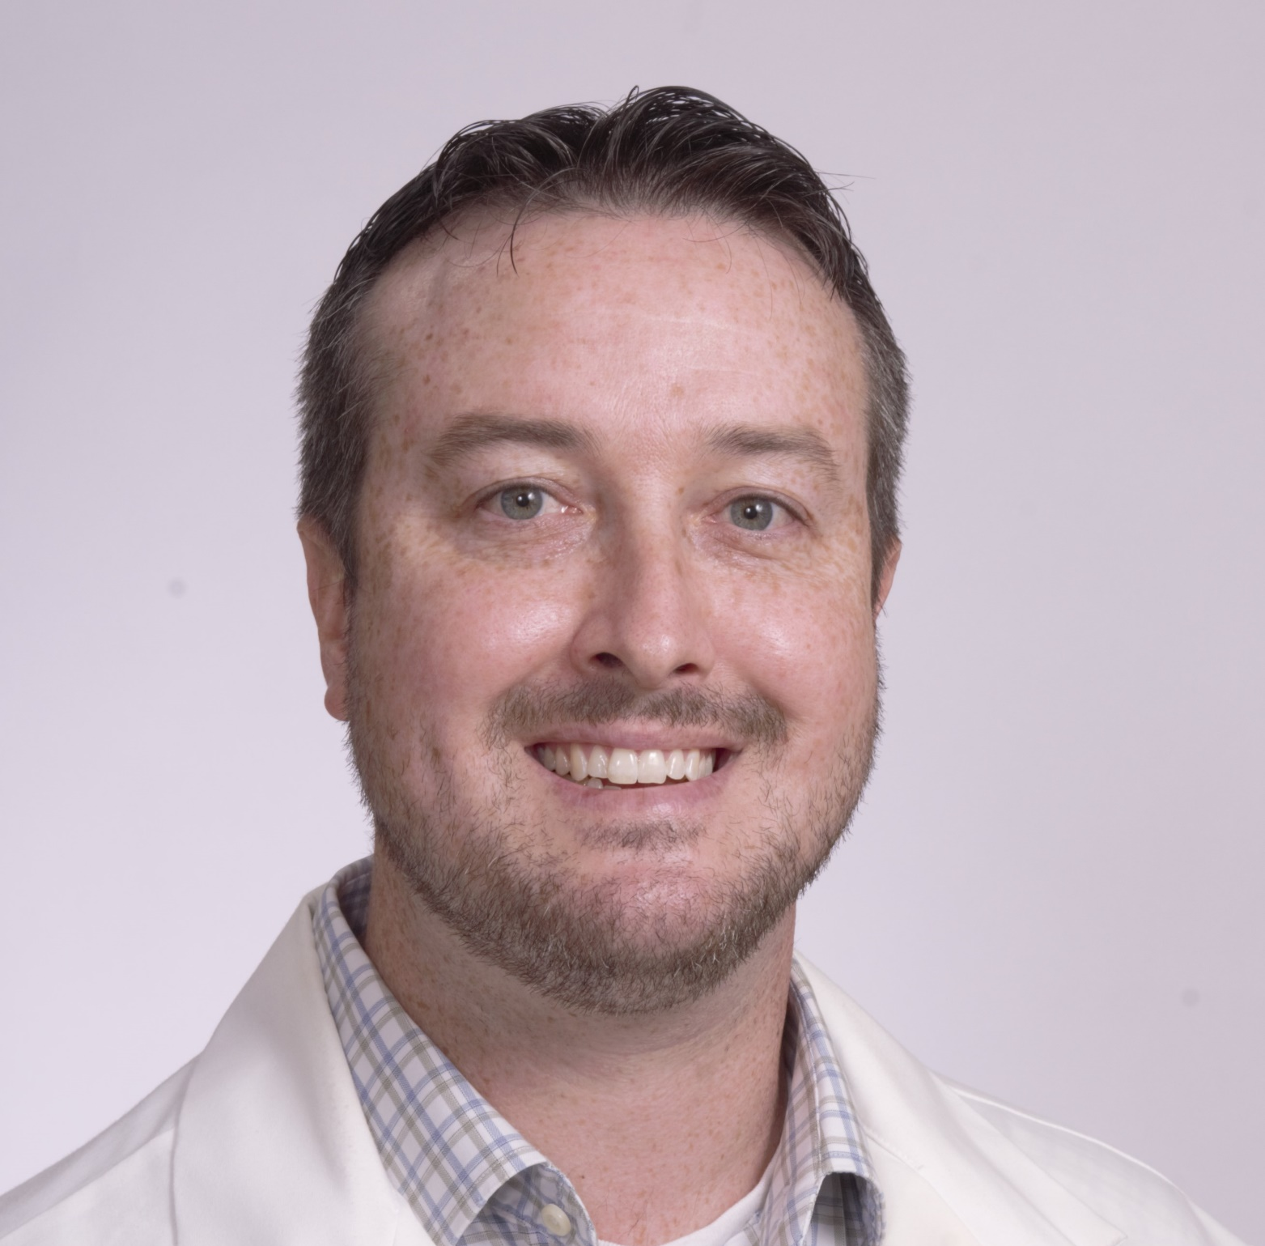
Brian Lowell, MD
Family Medicine, Sports Medicine
Fellowship/Residency faculty
Team Physician, Univ. of Portland

Slide 23
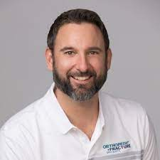
Brian Bettencourt, DO
Family Medicine, Sports Medicine
Head Team Physician, Univ. of Portland

Slide 24
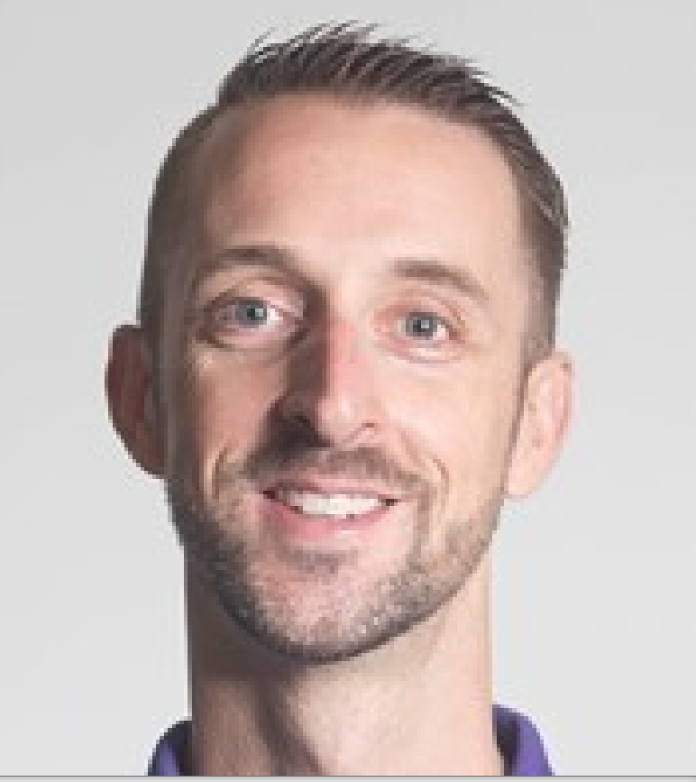
Sam Gay, ATC
Head Athletic Trainer, U. of Portland

Slide 25


OHSU Faculty
FM/Sports, EM/Sports
  Didactics, Cadaver USG injection labs

Slide 26
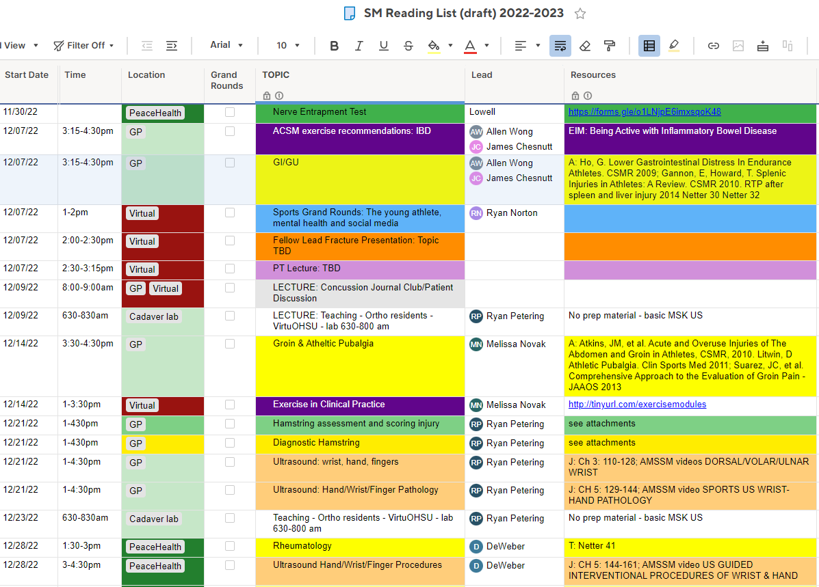
Didactics: sample from online spreadsheet

Slide 27
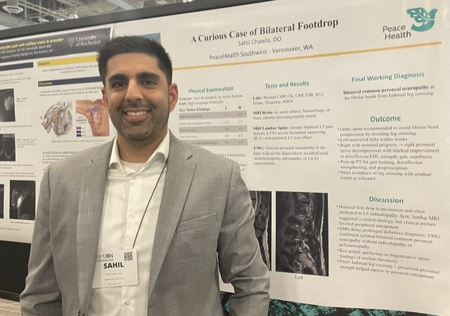
Scholarly Activities
Review article or book chapter, any topic
AMSSM presentation
QI project
Other as desired

Slide 28
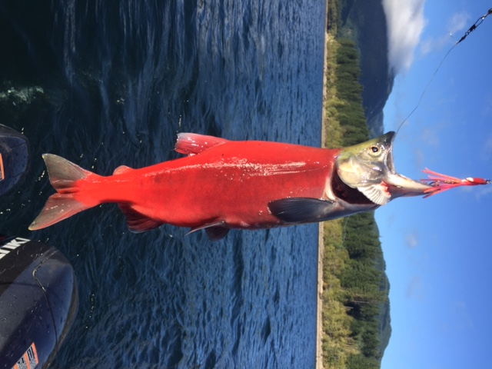
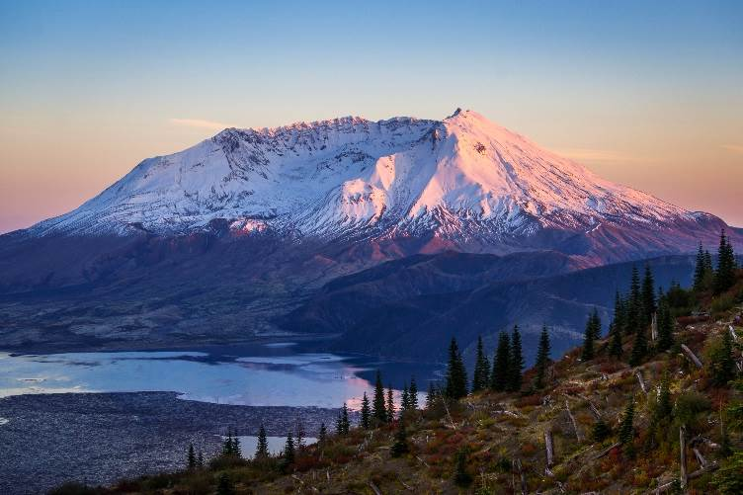
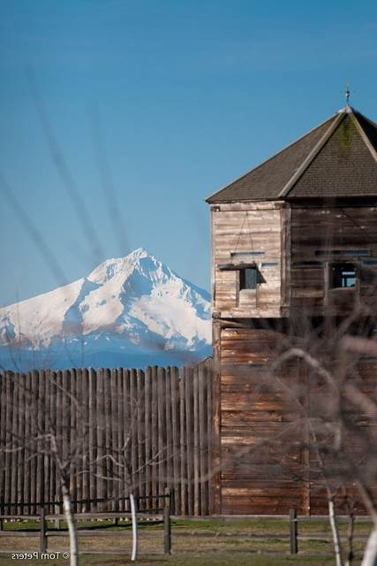
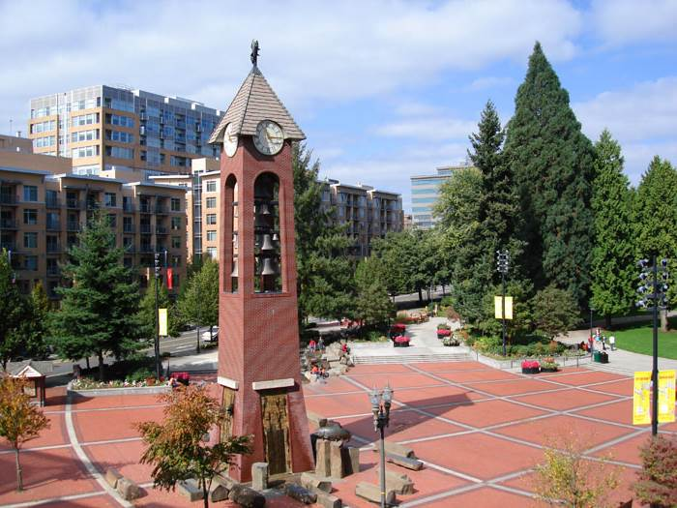

And in your time off…

Slide 29

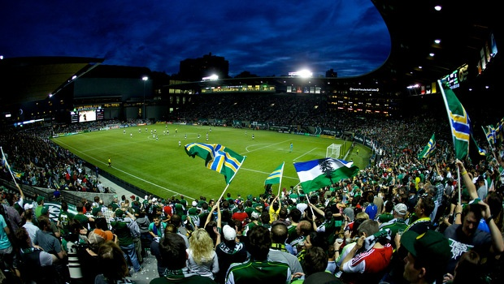
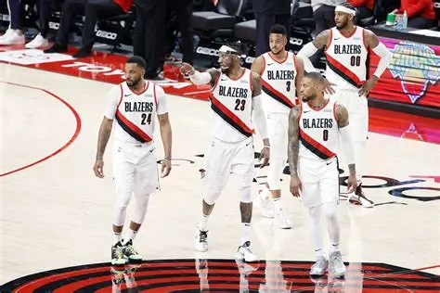


Slide 30
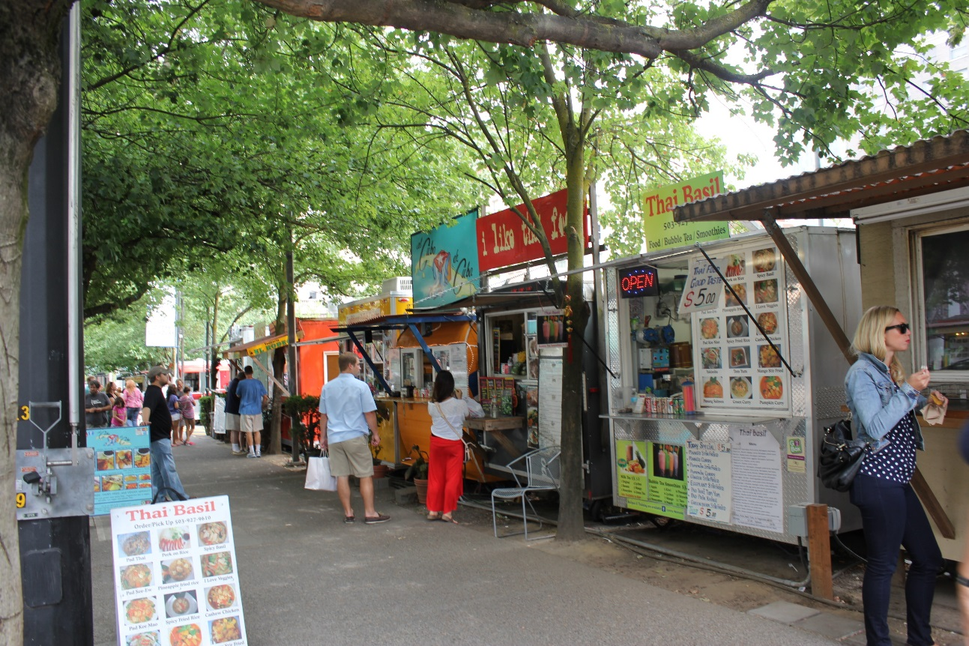
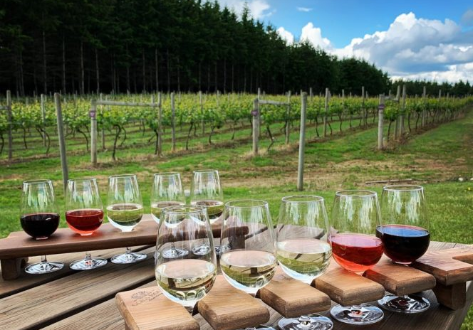

Slide 31
Salary and Benefits
$88,046/yr salary 2026-27
  Tax-free!
28 days paid-time-off (PTO)
  21 days vacation/sick
  7 clinic holidays
Paid WA and OR licenses
Paid CME trips (doesn’t count twd PTO)
  AMSSM annual meeting
  Advanced Team Physician Course
Benefits…

Slide 32
Questions?

