Slide 1

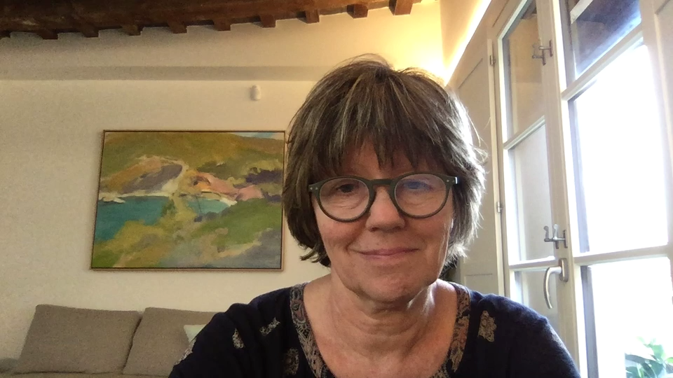
Welcome to Family Medicine of
Southwest Washington
Curriculum Overview: Rae Wright, MD - Faculty
Notes:
Hello, my name is Rae Wright. I am the faculty in charge of education and resident curriculum. My job is to work with the program director, residency coordinator and the scheduling team to create and sustain a dynamic curriculum that meets the needs of our residents and our community. I have been at FMSW for over 20 years and, I definitely feel like I am part of a big extended family. I also work with the UW as the faculty in charge of curriculum development for the faculty development fellowship program.

Slide 2

Factors for Curriculum
ACGME
Requirements
Sponsoring Institution
Faculty expertise
Resident Interests
Patient
population
Notes:
So, what do I mean by curriculum?
Multiple factors go into creating a curriculum, starting with the ACGME requirements. These have been substantially updated this year and we are ready and excite to meet the challenge. After that, it all depends on the strengths and expertise of the institution and the faculty and residents you’ll be working with, combined with the needs of the patients and community which we all serve.

Slide 3
Curriculum Overview
Continuity Clinic
Inpatient Adult Medicine
Maternal Child Health
Care of Underserved
Behavioral Health and Addiction Care
Musculoskeletal Health and Sports Medicine
Professional Development
Lifelong Learning
Notes:
These blocks represent the major categories within our curriculum. Most of the time in our program is focused on these areas, which a particular focus on maximizing the Continuity Clinic experience.

Slide 4
Competency-Based
Curriculum
Individualized Learning Plans
Timely Feedback
Advising and Coaching
Focused elective time
Clear goals and expectations
Notes:
Like most medical schools, family medicine residency programs are redefining what it means to facilitate a competency based education.
The major components of a comp based curriculum are shown here, with the individual learning plan as the most vital piece. The remainding pieces provide a picture of how we focus our efforts as a program. We want our residents to not only excel while with us, but to continue to grow and excel throughout their career.

Slide 5
Something in between
Block?
Longitudinal?
Notes:
Once we establish the “what we teach” or the content of the curriculum, we have to put a structure together that provides the framework for “how we teach”.
You have likely heard programs describe themselves as primarily “block” or primarily “longitudinal”. We think of ourselves as somewhere in between, hopefully combining the best aspects of each.
The next few slides will help explain this more.

Slide 6
Short Blocks
Abbreviation | Rotation Name | R-1 Weeks | R-2 Weeks | R-3 Weeks
Essentials | Family Medicine Essentials/Orientation | 4 | 0 | 0
LFM | Longitudinal Family Medicine Continuity Clinic Focus | 16 | 14 | 17-18
LFM with Gyn Focus | LFM with Outpatient GYN | 0 | 2 | 2
LFM w/MSK Focus | LFM with musculoskeletal medicine experiences | 2 | 2 | 2
LFM w/ Proc Focus | LFM with procedure clinics | 0 | 4 | 2
ER | Emergency Medicine | 0 | 4 | 2
OB-Gyn | Inpatient OB with Outpatient GYN | 0 | 1 | 1
Out Peds | Outpatient Pediatrics | 0 | 4 | 4
Inpt Peds | R1 Inpatient Pediatrics at Randall’s Children’s Hospital | 6 | 0 | 0
MCH | Maternal Child Health | 6 | 5 | 2
Med | Inpatient Medicine | 12 | 4 | 4
Nights | Nights covering Maternal Child Health Service | 0 | 3 | 3.5
Elect | Electives | 6 | 8 | 13
Notes:
This table provides an overview of which experiences are primarily taught in block rotation format in our program. You can see here a list of the various curricular areas that are organized as 1 or 2 week blocks and how many weeks each are included in each academic year.
I want to specifically draw you attention to the blocks with the letters LFM. This is our Longit Family Med experience with a focus on continuity clinic and other educational experiences that are more difficult to schedule in a traditional block format. Most of the short blocks on this table are dedicated to inpatient experiences where a more intense immersion experience might work better.

Slide 7
Longitudinal Family Medicine (example experiences)
Session Name | Comments
Addiction Medicine | Multiple sites
Behavioral Health | Integrated into FMSW Clinic
Dermatology | Off-site
Free Clinic/Care of the Unhoused | Off-site
Geriatrics | Multiple sites including Nursing Home
Hospice | Off-site
Sub-specialty care | Multiple sites
Teen Clinic | Integrated into FMSW Clinic, includes SUD care
Urgent Care | PeaceHealth
Notes:
This table shows the experiences that are integrated and primarily taught longitudinally. This allows more flexibility with scheduling and provides more opportunities that as mentioned befofe, might not otherwise be available if done in block format. Our scheduling team keeps a massive spreadsheet to keep up with exactly how many times each resident has with each of these sessions, assuring that everyone has the same number of sessions at the end of residency.
Briefly, let’s look at what 2 weeks on LFM might look like:

Slide 8
R1 Track Example 2023
Twenty-Six 2-Week Blocks
Notes:
This is how the blocks play out in the actual schedule. This is an example of our R-1 schedule. Let’s start by getting oriented. The top row shows weeks in the academic year, in 2-week increments, divided into 3 Trimesters. The first column designates 2 residents who have this schedule for the year as either track A-1 or B-1. This slide shows 2 schedules, for 2 of our 8 residents. It all fits together like a puzzle in the end, insuring we have the right number of people on each rotation and avoiding any unnecessary overlap by design.
If we look at this in more detail, the resident with Track A-1 schedule:
• Like all R-1s, it starts with 2 weeks of Essentials. This is sort of like an extended orientation experience where our new residents spend extra time getting to know their team, completing EMR training and having some 1 on 1 time with attendings to start the year off successfully.
• After this 2 week period, the blocks start to rotate in a pattern, with predominantly outpatient rotations designated with LFM alternating with more time intensive, predominantly inpatient experiences such as inpatient medicine. The goal of this pattern is 3 fold:
1. It minimizes burn out from long periods of time on inpatient rotations where you don’t get to see your family or your dog or do the things you love.
2. It allows more time in your continuity clinics to foster relationships with your assigned primary care patients and your clinic team
3. And it provides a more even distribution of your time, so you don’t go long periods away from any particular experience. This is where the Trimesters come in, as each trimester is balanced with the others.
•

Slide 9
R1 Longitudinal FM (example)
Week 1 – Longitudinal Family Medicine
 | Monday | Tuesday | Wednesday | Thursday | Friday | Saturday | Sunday
AM | CLINIC | CLINIC | Professional Development | CLINIC | CLINIC
PM | ADHD CLINIC | ENT | CLINIC | Didactics | ENT
Week 2 – Longitudinal Family Medicine
 | Monday | Tuesday | Wednesday | Thursday | Friday | Saturday | Sunday
AM | CLINIC | Nourish Clinic | Professional Development | Clinic | Neurology
PM | CLINIC | Hospice | BLOOM CLINIC | Didactics | Neurology
Notes:
If we break this down more, you see can see what a particular 2 weeks of Longitudinal FM might look like. There is a focus on continuity clinic, with a few other experiences such as our BLOOM clinic which is dedicated to caring for pregnant and postpartum women with SUD, and other sub-specialty clinics mixed in. These experiences will be sprinkled in throughout the 3 years in this way.

Slide 10
R2 Track Example 2023
Twenty-Six 2-Week Blocks
Notes:
This is an example of an R-2 schedule. The structure is primarily the same as that of an R-1, with 2 specific additions I want to highlight. R-2s residents start off with 3-week of professional development. This is done as a group by all R-2s to help establish their individual priorities for the remainder of their training. Residents work on their CV, start long term QI projects and plot elective time. The Second addition I want to mention is that of 1 Week blocks of nights. While our program does not require an inpatient medicine nightfloat experience, we do have weeks of nights spent in house covering our MCH service. Each R-2 and R-3 resident will spend 3 weeks covering this MCH service spaced out over each of the 2 years. The R-2 year also has a bit less inpatient focus overall compared to the R-1 year.

Slide 11
R3 Track Example 2023
Twenty-Six 2-Week Blocks
Notes:
This shows the R-3 schedule. Highlights here include less inpatient time and the vast majority of elective time. There is a wide variety of elective choices we provide, or residents can create their own. We have found over time that reserving this time for the R-3 year facilitates elective choices that are better targeted to the individual resident as they are fine tuning their residency experience and moving toward their final goals.

Slide 12
Areas of Concentration
Maternal-Child Health (OB)
Sports and Exercise Medicine
Leadership/Faculty Development
HIV
Addiction Medicine
Integrative Medicine
Other by design
Notes:
In addition to our robust curriculum we just reviewed, we also offer Areas of Concentration, known as AOCs. These are offered to those who are interested in focusing their efforts in one particular area. What we see here are examples of AOCs that are most commonly done in our program. If interested, residents are asked to let us know at the beginning of their R-2 year and are then matched with a faculty with additional expertise in that area for mentorship. Each AOC has its own set of goals and objectives and requires the use of 4-8 weeks of focused elective time to meet requirements.

Slide 13
Didactics
Inpatient mini-didactics
Outpatient case based noon conferences
Weekly half-day
Notes:
The last part of the curriculum I want to touch on is our didactics. Our didactics are also done both longitudinally and in blocks. Inpatient rotations have a daily, targeted didactic component. Our clinic based noon conferences are done 1-2 days per week focused on outpatient topics that are case-based. Additionally, we have weekly Teaching Afternoons that provide more focused group time. Most of our didactics are done in person, and supplemented with video conferencing when needed.

Slide 14
Professional Development
Weekly Half Day Dedicated to:
Health Systems Management
Quality Improvement
Population Health
Scholarly Activity
Notes:
Our newest addition to the curriculum is dedicated HSM, QI, pop health, and scholarly activity. This is a longitudinal curriculum that residents attend weekly as a group with 1-2 faculty assigned to provide structured teaching and process development in these areas.

Slide 15
Resident Wellbeing
Quarterly sessions as a class
Personal days
Accommodation for appointments
Teamwork
Notes:
Finally, we want to foster an atmosphere of healthy residents in mind, body and spirit.
In addition to our curriculum design, we strive to create opportunities to allow individual residents respite when needed.

Slide 16
Summary
Combo of longitudinal and block experiences
2-week rotations to promote educational and personal balance
Diverse, flexible curriculum committed to meeting the educational needs of each resident
Notes:
In summary, I know this is a lot to cover, so want to emphasize 3 things that I think best describe our curriculum:
1. We provide a combination of longitudinal and block experiences
2. We have a 2 week rotation schedule that promotes educational and personal balance
3. And our curriculum is both structured and provides the flexibility needed to meet the education needs of our residents as a group and as individuals.
I appreciate your time and hope to have the opportunity to meet you in the near future. In the meantime, I hope you will reach out to us directly if you have any clarifying questions.
Thank you.

Slide 17

Notes:
We appreciate your time and hope to have the opportunity to meet you in the near future. In the meantime, I hope you will reach out to us directly if you have any clarifying questions.
Thank you.

