Slide 1
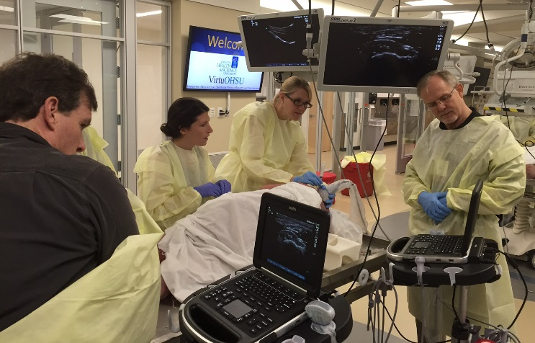
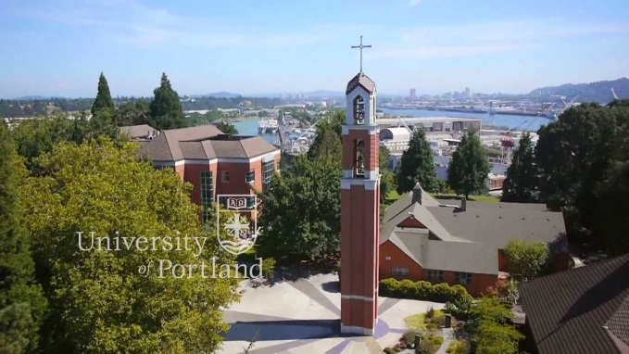
Southwest Washington Sports Medicine Fellowship
Kevin deWeber, MD, FAMSSM, FAAFP, FACSM, RMSK
Program Director

Slide 2
Overview
PeaceHealth
Residency
Fellowship
Faculty
Training sites
Schedule template
Salary and Benefits

Slide 3
PeaceHealth is a not-for-profit health care system with medical centers, critical access hospitals, medical clinics and laboratories located in Alaska, Oregon and Washington.

Slide 4
PeaceHealth Networks

Slide 5
Notes:
450 beds and Level II trauma center.

Slide 6
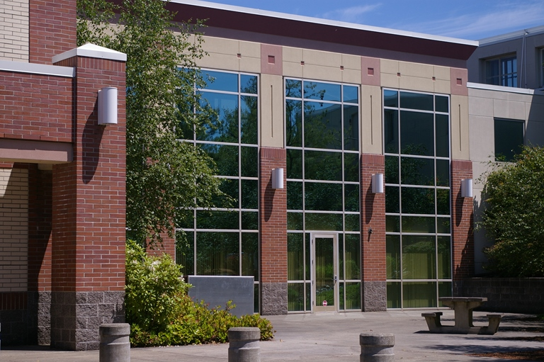
Family Medicine of SW Washington Residency & Fellowship Clinic
24 faculty, 2 PA’s
24 residents, 1 fellow
Radiology, Urgent C.
Physical Therapy
Pharmacology
Behavioral Health
Specialties:
SportsMed, OMT, Integrative Med, Ob/Gyn, Endo, HIV

Slide 7
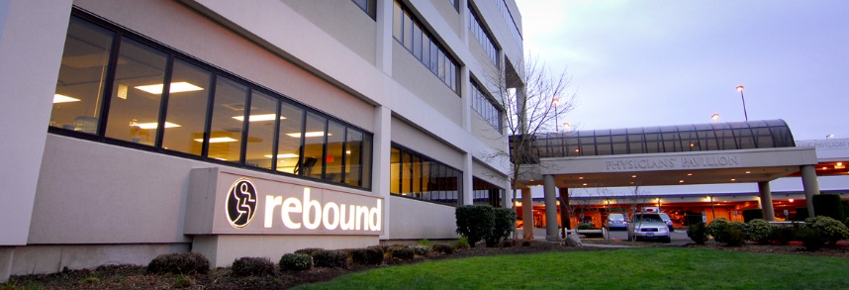
Fellowship Training Sites
Primary Care Sports Med:
4 hd/wk
FM Clinic
2 hd/wk
Orthopedics:
2 hd/wk
Team Physician:
2 TR clinics/wk + games
Didactics & Ultrasound
1 hd/wk

Slide 8
University of Portland Team Physician experience, Div 1A
275-300 athletes
Sports:
Soccer
VB
Basketball
Baseball
XC, T&F
Tennis
Rowing

Slide 9
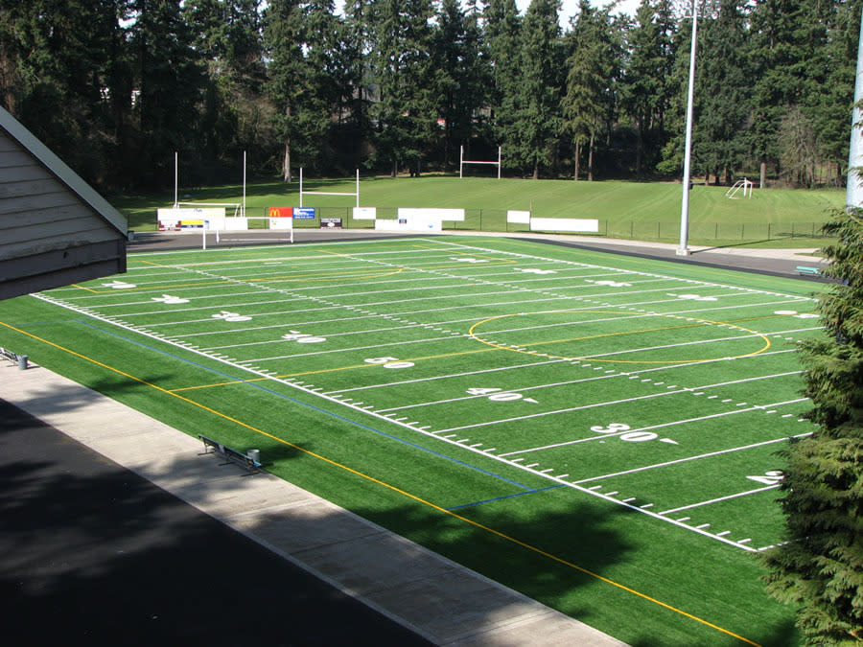
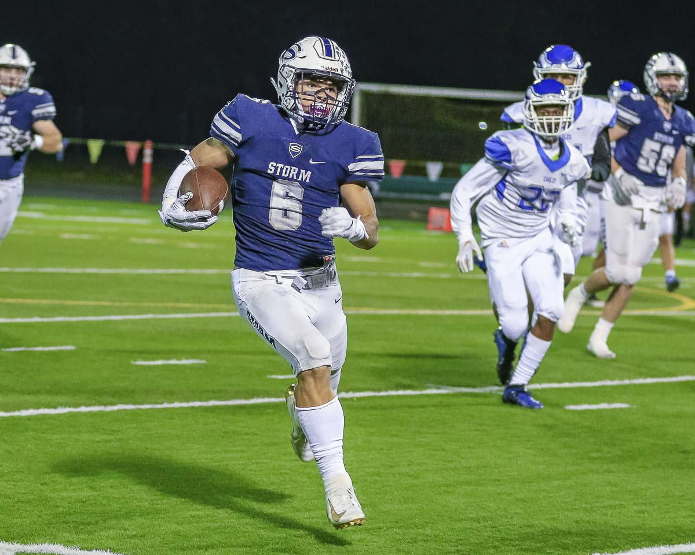
4-A High School Football

Slide 10
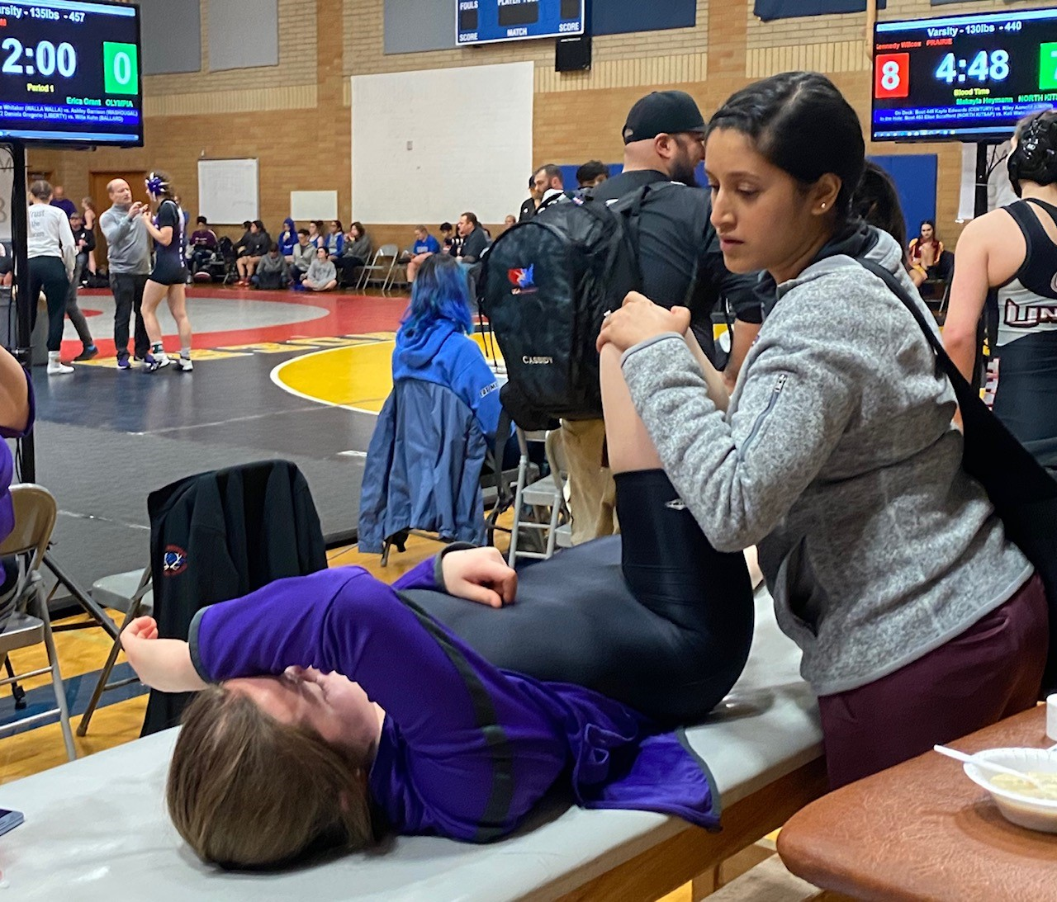
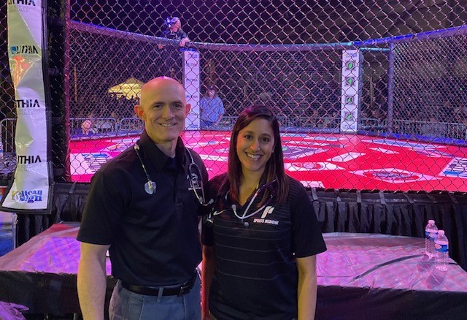
Other event coverage
Mass participation races
OR state wrestling tournament
Optional
MMA and boxing

Slide 11
Where is all that?
80%
10%
10%
U of P
OHSU

Slide 12
Family Medicine Clinic
2 hd/wk at FMSW
May include OMT clinic for DO’s

Slide 13
Weekly Template

Slide 14
Key Faculty

Slide 15
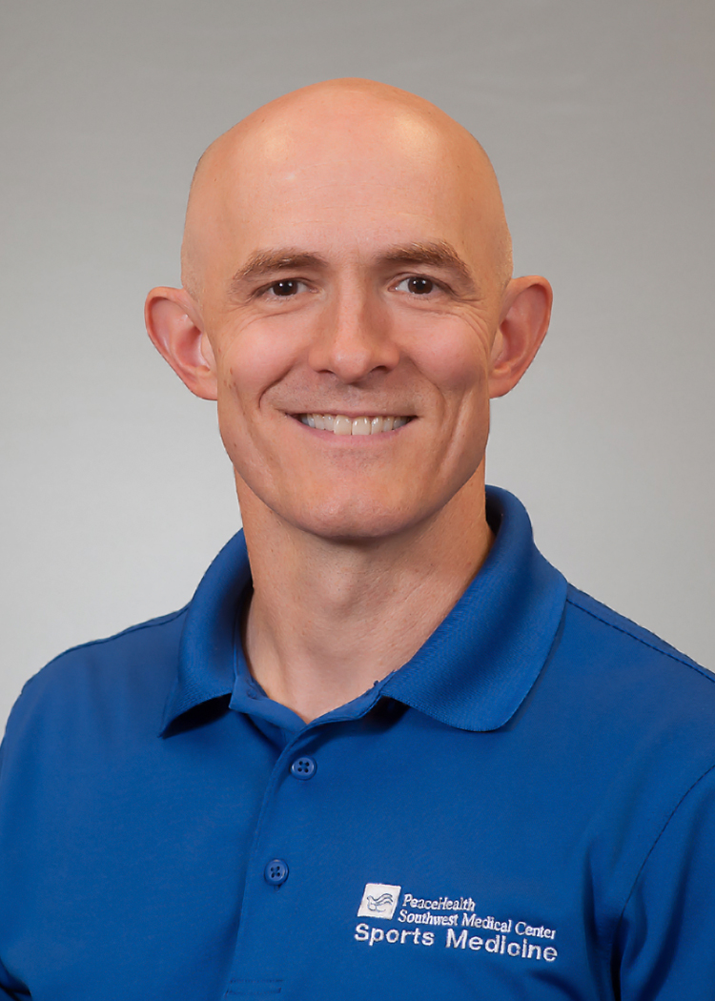
Kevin deWeber, MD, FAMSSM, FAAFP, FACSM, RMSK
Program Director and founder 2015
Residency ‘92-’95, Fellowship ‘00-’01
Military Fellowship Director 6 years
24 graduates
Teaching US since 2008
RMSK “pioneer” 2012
AMSSM West Coast course director
US Olympic Medical Team 2012 & 2016

Slide 16
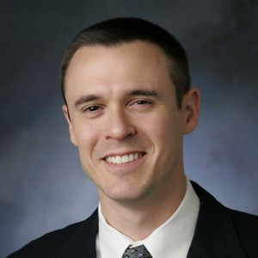
Jerod Cotrill, DO, RMSK
PM&R and Sports Med boarded
Rebound Orthopedics
Team Physician, Portland Trailblazers
USA Ski Team physician

Slide 17
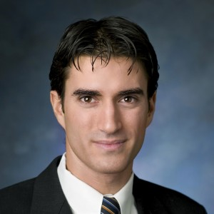
Jerome DaSilva, MD, FRCSC
Orthopedic Sports Medicine
Rebound Orthopedics
Team Physician, Portland Winterhawks hockey and Clark College

Slide 18
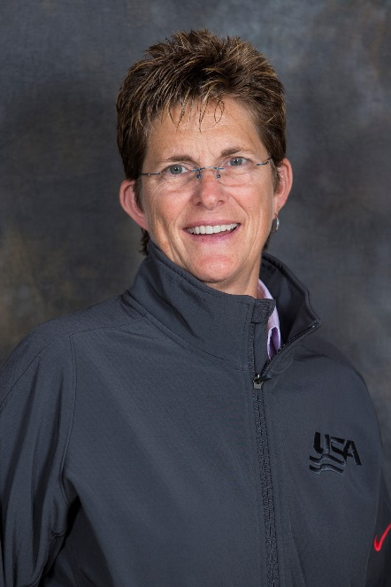
Jaime Schlueter, DO
Emergency Medicine, Sports Medicine
Head Team Physician, Univ. of Portland
US Olympic Team
Sochi 2014 Olympics
Rio 2016 Paralympics

Slide 19
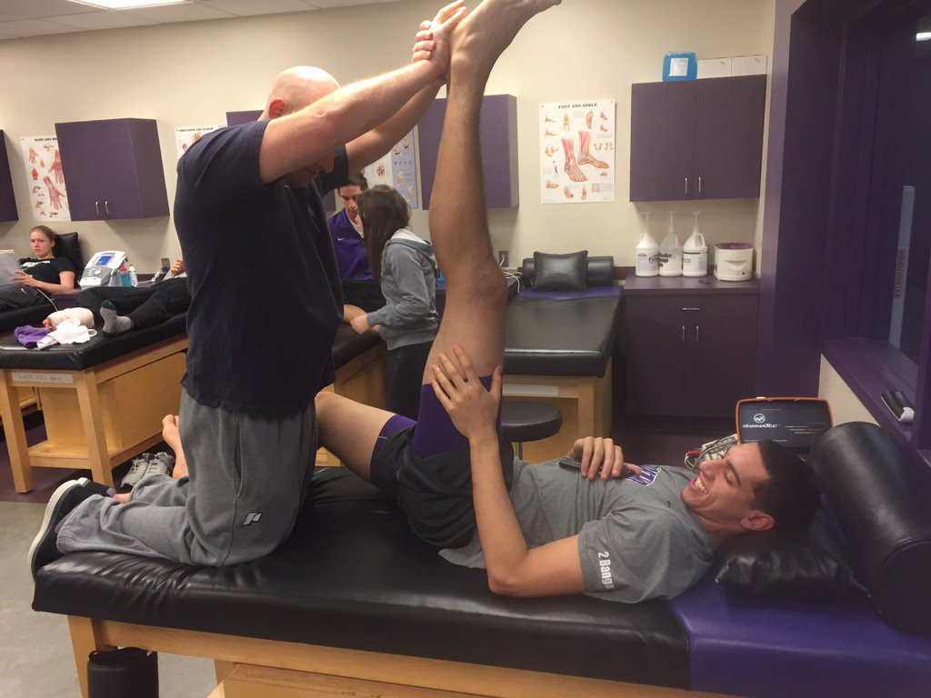
Athletic Trainers

Slide 20
OHSU Faculty
Ryan Petering, FM/Sports (& others)
Didactics, Cadaver USG injection labs
Kerry Kuehl, MD, DrPH
Human Performance Lab

Slide 21
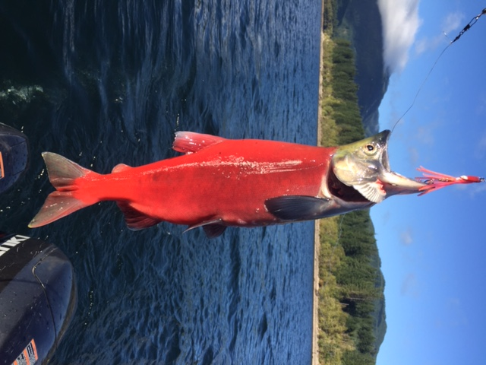
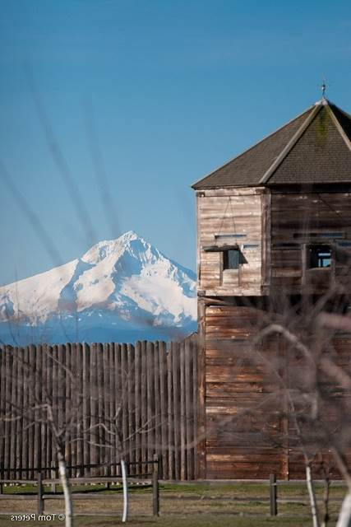
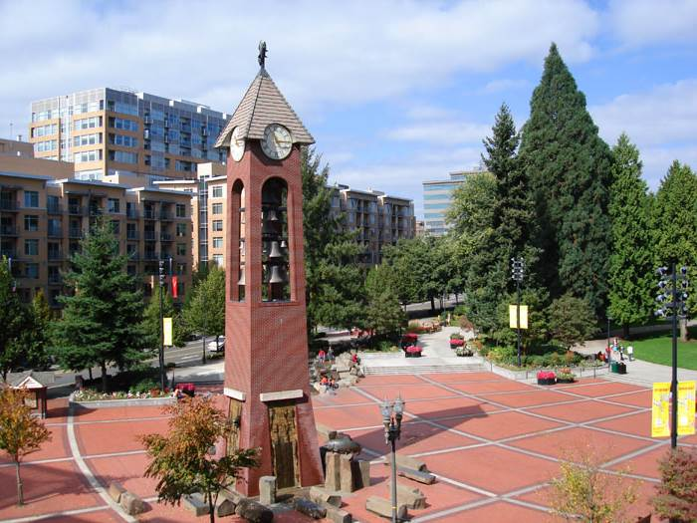
And in your time off…

Slide 22
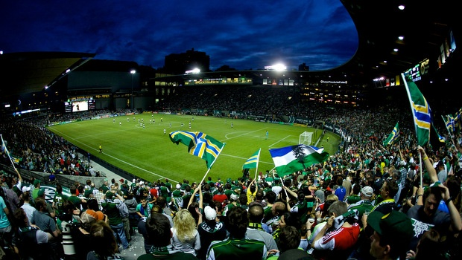
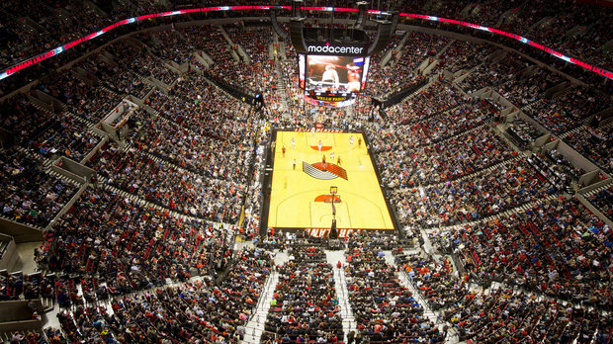

Slide 23
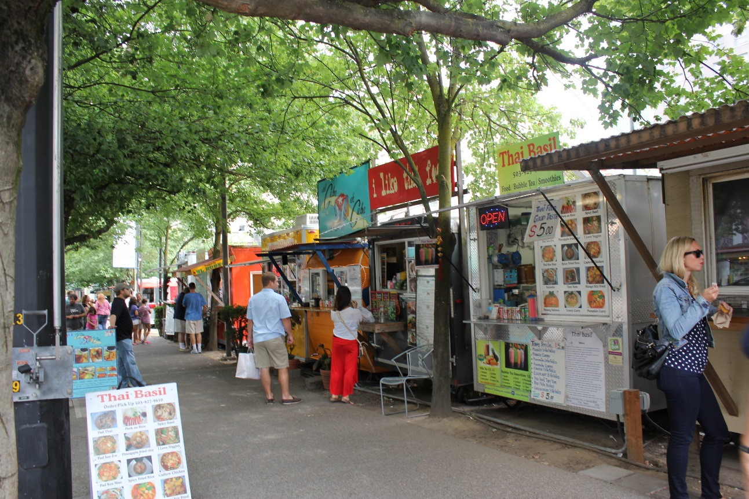

Slide 24
Salary and Benefits
$69,000/yr salary
28 days paid-time-off (PTO)
21 days vacation/sick
7 clinic holidays
Paid WA and OR licenses
Paid CME trips (doesn’t count twd PTO)
AMSSM annual meeting
Advanced Team Physician Course
Benefits…

Slide 25
Questions?

