Slide 1
EKG’s: for Basic EMS Providers (ok, and medics too.)

Slide 2
Jim Cole, LP, MAHE, NRP, FP-C, CEMSO, CMTE
EMS Coordinator
PeaceHealth Oregon Network
jcole3@peacehealth.org
541-222-1794
www.peacehealth.org/ems

Slide 3
Course Objectives
To recognize the normal rhythm of the heart - “Normal Sinus Rhythm.”
To recognize the common rhythm disturbances.
Practice this new knowledge

Slide 4
Learning Modules
ECG Basics
How to Analyze a Rhythm
Normal Sinus Rhythm
Heart Arrhythmias

Slide 5
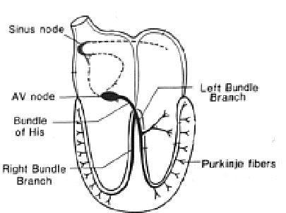
Normal Impulse Conduction
Sinoatrial node
AV node
Bundle of His
Bundle Branches
Purkinje fibers

Slide 6
The “PQRST”
P wave - Atrial depolarization
QRS - Ventricular depolarization
T wave - Ventricular repolarization

Slide 7
The PR Interval
Atrial depolarization
+
delay in AV junction
(AV node/Bundle of His)
(delay allows time for the atria to contract before the ventricles contract)

Slide 8
Pacemakers of the Heart
SA Node - Dominant pacemaker with an intrinsic rate of 60 - 100 beats/minute.
AV Node - Back-up pacemaker with an intrinsic rate of 40 - 60 beats/minute.
Ventricular cells - Back-up pacemaker with an intrinsic rate of 20 - 45 bpm.

Slide 9
The ECG Paper (cont)
3 sec
3 sec
Every 3 seconds (15 large boxes) is marked by a vertical line.
This helps when calculating the heart rate.
NOTE: the following strips are not marked but all are 6 seconds long.

Slide 10
Learning Modules
ECG Basics
How to Analyze a Rhythm
Normal Sinus Rhythm
Heart Arrhythmias

Slide 11
Rhythm Analysis
Step 1: Calculate rate.
Step 2: Determine regularity.
Step 3: Assess the P waves.
Step 4: Determine PR interval.
Step 5: Determine QRS duration.

Slide 12
Step 1: Calculate Rate
300
150
100
75
60
50
Option 2 (cont)
Memorize the sequence:
300 - 150 - 100 - 75 - 60 - 50
Interpretation?
Approx. 1 box less than 100 = 95 bpm

Slide 13
Step 3: Assess the P waves
Are there P waves?
Do the P waves all look alike?
Do the P waves occur at a regular rate?
Is there one P wave before each QRS?
Interpretation?
Normal P waves with 1 P wave for every QRS

Slide 14
Step 4: Determine PR interval
Normal: 0.12 - 0.20 seconds.
(3 - 5 boxes)
Interpretation?
0.12 seconds

Slide 15
Step 5: QRS duration
Normal: 0.04 - 0.12 seconds.
(1 - 3 boxes)
Interpretation?
0.08 seconds

Slide 16
Rhythm Summary
Rate 90-95 bpm
Regularity regular
P waves normal
PR interval 0.12 s
QRS duration 0.08 s
Interpretation?
Normal Sinus Rhythm

Slide 17
Learning Modules
ECG Basics
How to Analyze a Rhythm
Normal Sinus Rhythm
Heart Arrhythmias

Slide 18
Normal Sinus Rhythm (NSR)
Etiology: the electrical impulse is formed in the SA node and conducted normally.
This is the normal rhythm of the heart; other rhythms that do not conduct via the typical pathway are called arrhythmias.

Slide 19
NSR Parameters
Rate 60 - 100 bpm
Regularity regular
P waves normal
PR interval 0.12 - 0.20 s
QRS duration 0.04 - 0.12 s
Any deviation from above is sinus tachycardia, sinus bradycardia or an arrhythmia

Slide 20
Arrhythmia Formation
Arrhythmias can arise from problems in the:
Sinus node
Atrial cells
AV junction
Ventricular cells

Slide 21
Teaching Moment
A re-entrant pathway occurs when an impulse loops and results in self-perpetuating impulse formation.

Slide 22
Atrial Cell Problems
Atrial cells can also:
• fire continuously from multiple foci
or
fire continuously due to multiple micro re-entrant “wavelets”
Atrial Fibrillation
Atrial Fibrillation

Slide 23
AV Junctional Problems
The AV junction can:
fire continuously due to a looping re-entrant circuit
block impulses coming from the SA Node
Paroxysmal Supraventricular Tachycardia
AV Junctional Blocks

Slide 24
Ventricular Cell Problems
Ventricular cells can:
fire occasionally from 1 or more foci
fire continuously from multiple foci
fire continuously due to a looping re-entrant circuit
Premature Ventricular Contractions (PVCs)
Ventricular Fibrillation
Ventricular Tachycardia

Slide 25
Learning Modules
ECG Basics
How to Analyze a Rhythm
Normal Sinus Rhythm
Heart Arrhythmias

Slide 26
Arrhythmias
Sinus Rhythms
Premature Beats
Supraventricular Arrhythmias
Ventricular Arrhythmias
AV Junctional Blocks

Slide 27
Sinus Rhythms
Sinus Bradycardia
Sinus Tachycardia

Slide 28
Rhythm #1
Rate?
30 bpm
Regularity?
regular
P waves?
normal
PR interval?
0.12 s
QRS duration?
0.10 s
Interpretation?
Sinus Bradycardia

Slide 29
Sinus Bradycardia
Deviation from NSR
- Rate < 60 bpm

Slide 30
Sinus Bradycardia
Etiology: SA node is depolarizing slower than normal, impulse is conducted normally (i.e. normal PR and QRS interval).

Slide 31
Rhythm #2
Rate?
130 bpm
Regularity?
regular
P waves?
normal
PR interval?
0.16 s
QRS duration?
0.08 s
Interpretation?
Sinus Tachycardia

Slide 32
Sinus Tachycardia
Deviation from NSR
- Rate > 100 bpm

Slide 33
Sinus Tachycardia
Etiology: SA node is depolarizing faster than normal, impulse is conducted normally.
Remember: sinus tachycardia is a response to physical or psychological stress, not a primary arrhythmia.

Slide 34
Premature Beats
Premature Atrial Contractions (PACs)
Premature Ventricular Contractions (PVCs)

Slide 35
Rhythm #3
Rate?
70 bpm
Regularity?
occasionally irreg.
P waves?
2/7 different contour
PR interval?
0.14 s (except 2/7)
QRS duration?
0.08 s
Interpretation?
NSR with Premature Atrial Contractions

Slide 36
Premature Atrial Contractions
Deviation from NSR
These ectopic beats originate in the atria (but not in the SA node), therefore the contour of the P wave, the PR interval, and the timing are different than a normally generated pulse from the SA node

Slide 37
Premature Atrial Contractions
Etiology: Excitation of an atrial cell forms an impulse that is then conducted normally through the AV node and ventricles.

Slide 38
Teaching Moment
When an impulse originates anywhere in the atria (SA node, atrial cells, AV node, Bundle of His) and then is conducted normally through the ventricles, the QRS will be narrow (0.04 - 0.12 s).

Slide 39
Rhythm #4
Rate?
60 bpm
Regularity?
occasionally irreg.
P waves?
none for 7th QRS
PR interval?
0.14 s
QRS duration?
0.08 s (7th wide)
Interpretation?
Sinus Rhythm with 1 PVC

Slide 40
PVCs
Deviation from NSR
Ectopic beats originate in the ventricles resulting in wide and bizarre QRS complexes.
When there are more than 1 premature beats and look alike, they are called “uniform”. When they look different, they are called “multiform”.

Slide 41
PVCs
Etiology: One or more ventricular cells are depolarizing and the impulses are abnormally conducting through the ventricles.

Slide 42
Teaching Moment
When an impulse originates in a ventricle, conduction through the ventricles will be inefficient and the QRS will be wide and bizarre.

Slide 43
Arrhythmias
Sinus Rhythms
Premature Beats
Supraventricular Arrhythmias
Ventricular Arrhythmias
AV Junctional Blocks

Slide 44
Supraventricular Arrhythmias
Atrial Fibrillation
Atrial Flutter
Paroxysmal Supraventricular Tachycardia

Slide 45
Rhythm #5
Rate?
100 bpm
Regularity?
irregularly irregular
P waves?
none
PR interval?
none
QRS duration?
0.06 s
Interpretation?
Atrial Fibrillation

Slide 46
Rhythm #6
Rate?
70 bpm
Regularity?
regular
P waves?
flutter waves
PR interval?
none
QRS duration?
0.06 s
Interpretation?
Atrial Flutter

Slide 47
Atrial Flutter
Deviation from NSR
No P waves. Instead flutter waves (note “sawtooth” pattern) are formed at a rate of 250 - 350 bpm.
Only some impulses conduct through the AV node (usually every other impulse).

Slide 48
Rhythm #7
Rate?
74 →148 bpm
Regularity?
Regular → regular
P waves?
Normal → none
PR interval?
0.16 s → none
QRS duration?
0.08 s
Interpretation?
Paroxysmal Supraventricular Tachycardia (PSVT)

Slide 49
PSVT
Deviation from NSR
The heart rate suddenly speeds up, often triggered by a PAC (not seen here) and the P waves are lost.

Slide 50
Ventricular Arrhythmias
Ventricular Tachycardia
Ventricular Fibrillation

Slide 51
Rhythm #8
Rate?
160 bpm
Regularity?
regular
P waves?
none
PR interval?
none
QRS duration?
wide (> 0.12 sec)
Interpretation?
Ventricular Tachycardia

Slide 52
Ventricular Tachycardia
Deviation from NSR
Impulse is originating in the ventricles (no P waves, wide QRS).

Slide 53
Rhythm #9
Rate?
none
Regularity?
irregularly irreg.
P waves?
none
PR interval?
none
QRS duration?
wide, if recognizable
Interpretation?
Ventricular Fibrillation

Slide 54
Ventricular Fibrillation
Deviation from NSR
Completely abnormal.

Slide 55
Arrhythmias
Sinus Rhythms
Premature Beats
Supraventricular Arrhythmias
Ventricular Arrhythmias
AV Junctional Blocks

Slide 56
AV Nodal Blocks
1st Degree AV Block
2nd Degree AV Block, Type I
2nd Degree AV Block, Type II
3rd Degree AV Block

Slide 57
Rhythm #10
Rate?
60 bpm
Regularity?
regular
P waves?
normal
PR interval?
0.36 s
QRS duration?
0.08 s
Interpretation?
1st Degree AV Block

Slide 58
1st Degree AV Block
Deviation from NSR
PR Interval > 0.20 s

Slide 59
Rhythm #11
Rate?
50 bpm
Regularity?
regularly irregular
P waves?
nl, but 4th no QRS
PR interval?
lengthens
QRS duration?
0.08 s
Interpretation?
2nd Degree AV Block, Type I

Slide 60
2nd Degree AV Block, Type I
Deviation from NSR
PR interval progressively lengthens, then the impulse is completely blocked (P wave not followed by QRS).

Slide 61
Rhythm #12
Rate?
40 bpm
Regularity?
regular
P waves?
nl, 2 of 3 no QRS
PR interval?
0.14 s
QRS duration?
0.08 s
Interpretation?
2nd Degree AV Block, Type II

Slide 62
2nd Degree AV Block, Type II
Deviation from NSR
Occasional P waves are completely blocked (P wave not followed by QRS).

Slide 63
Rhythm #13
Rate?
40 bpm
Regularity?
regular
P waves?
no relation to QRS
PR interval?
none
QRS duration?
wide (> 0.12 s)
Interpretation?
3rd Degree AV Block

Slide 64
3rd Degree AV Block
Deviation from NSR
The P waves are completely blocked in the AV junction; QRS complexes originate independently from below the junction.

Slide 65
Remember
When an impulse originates in a ventricle, conduction through the ventricles will be inefficient and the QRS will be wide and bizarre.

Slide 66
Practice...

Slide 67
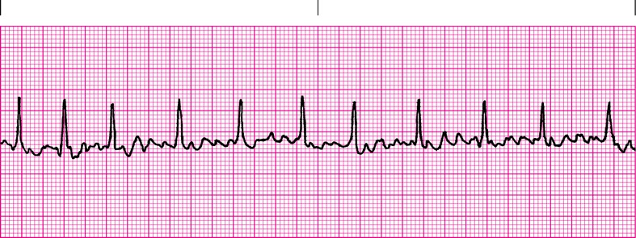
5.20

Slide 68
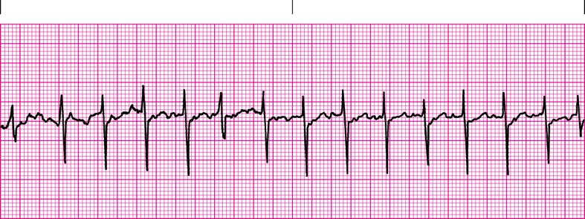
5.21

Slide 69
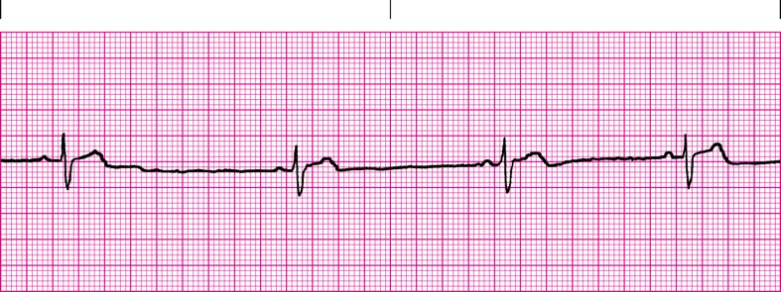
5.22

Slide 70
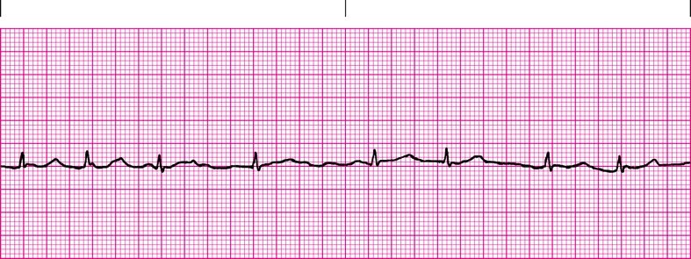
5.23

Slide 71
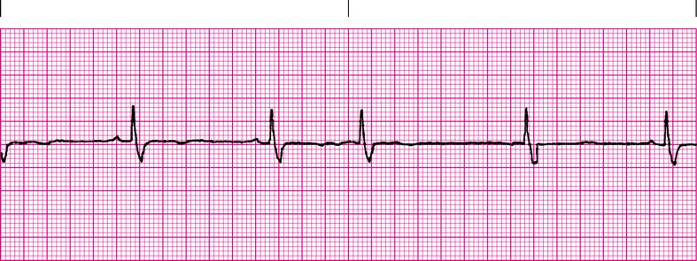
5.24

Slide 72
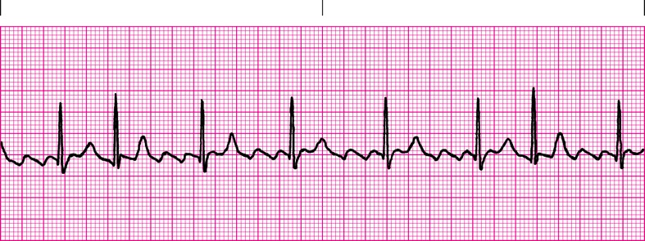
5.25

Slide 73
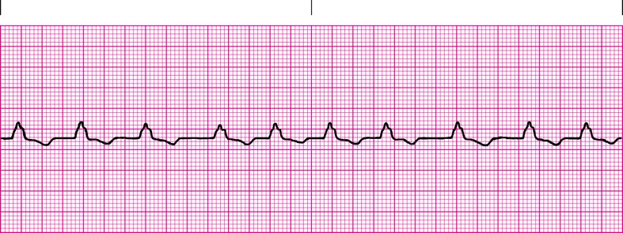
5.26

Slide 74
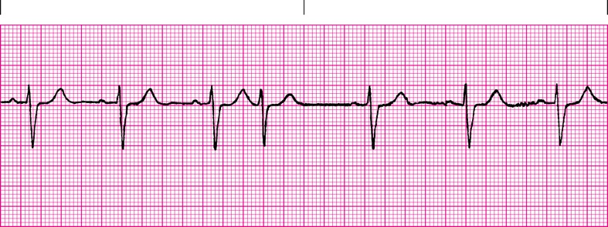
5.27

Slide 75
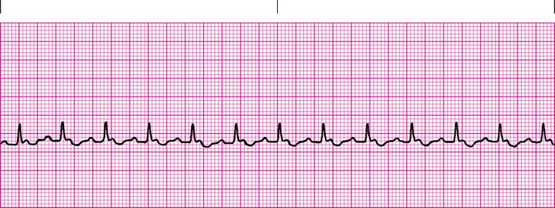
5.28

Slide 76
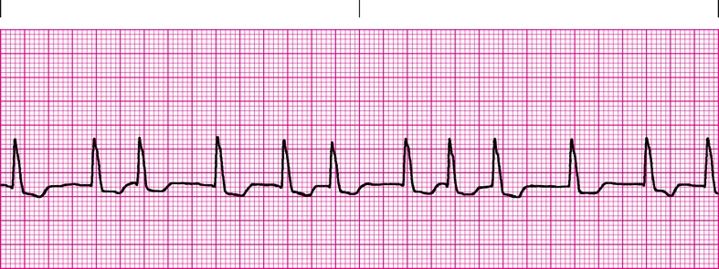
5.29

Slide 77
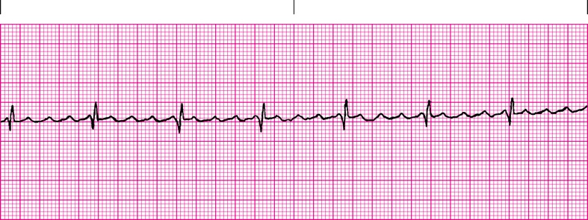
5.30

Slide 78
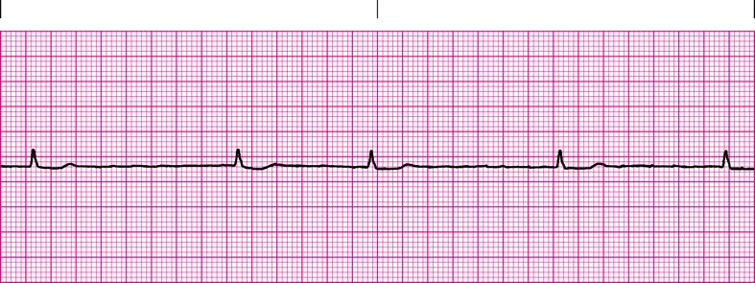
5.31

Slide 79
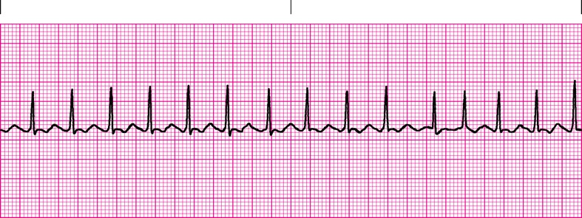
5.32

Slide 80
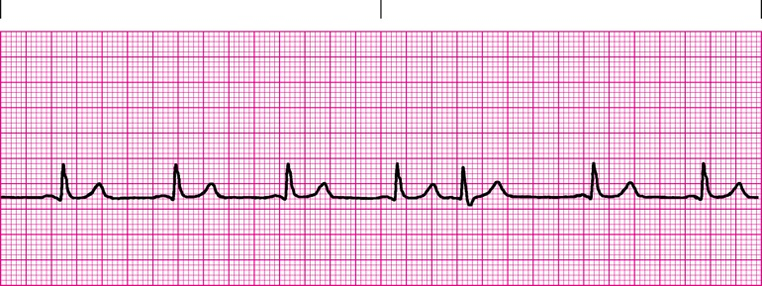
5.54

Slide 81
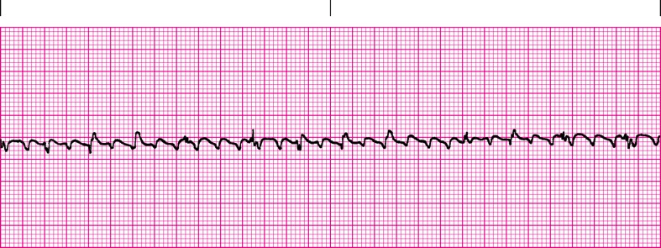
5.55

Slide 82
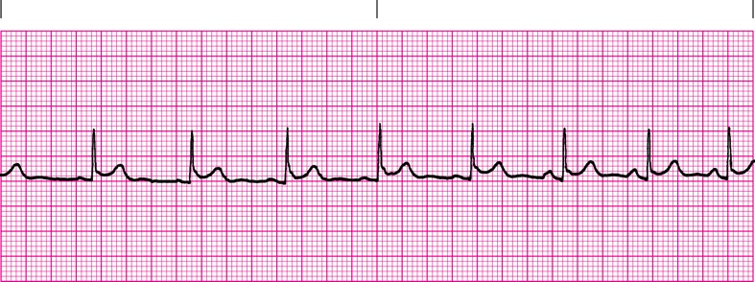
5.56

Slide 83
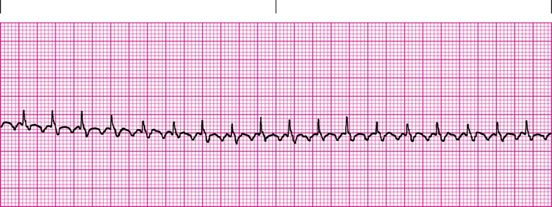
5.57

Slide 84
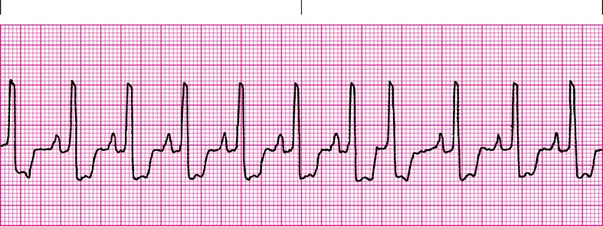
6.1

Slide 85
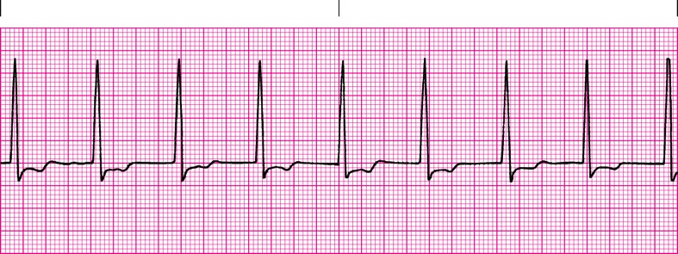
6.2

Slide 86
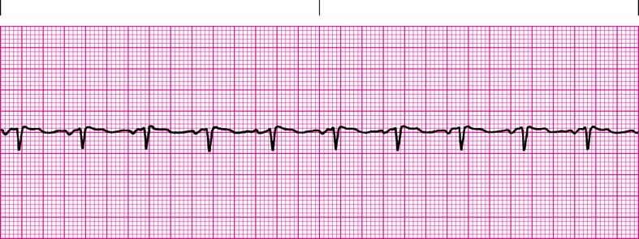
6.3

Slide 87
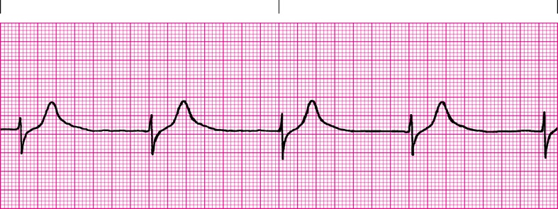
6.4

Slide 88
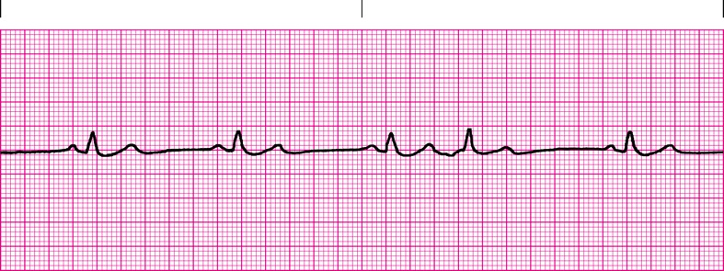
6.5

Slide 89
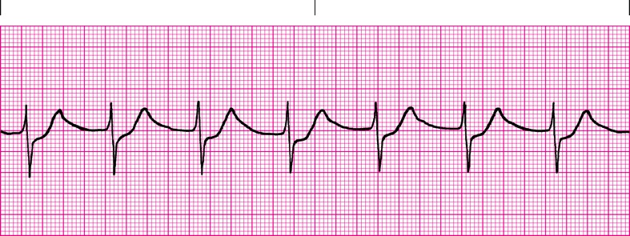
6.6

Slide 90
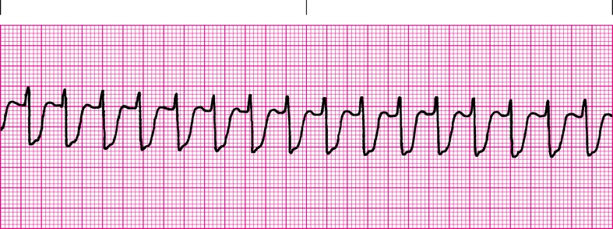
6.7

Slide 91
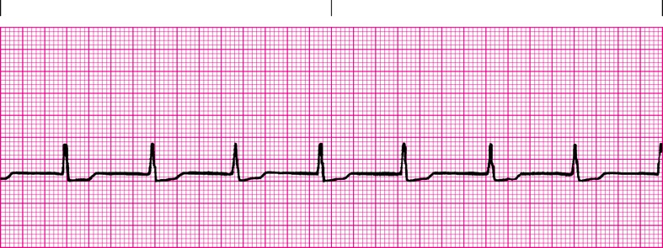
6.8

Slide 92
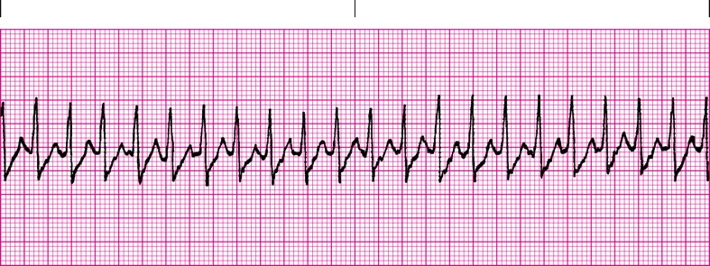
6.9

Slide 93
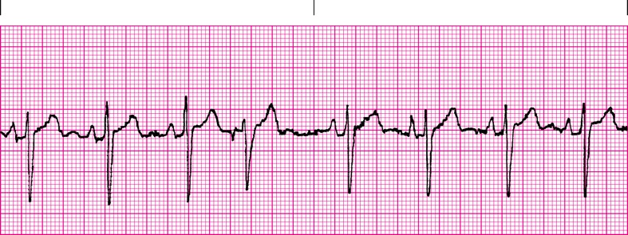
6.10

Slide 94
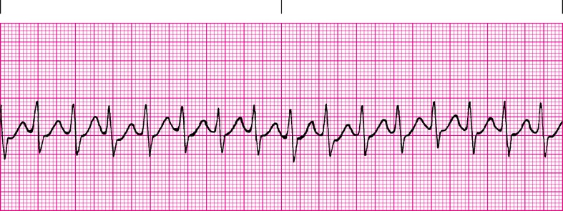
6.11

Slide 95
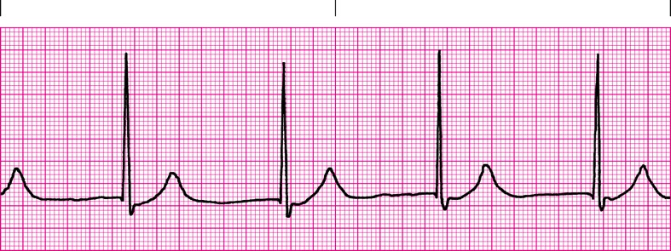
6.12

Slide 96
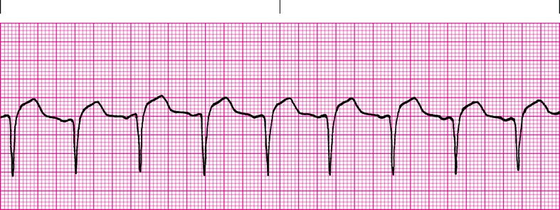
6.13

Slide 97
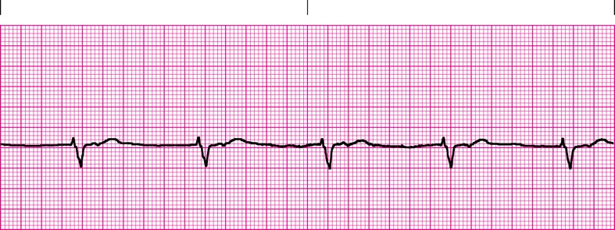
6.14

Slide 98
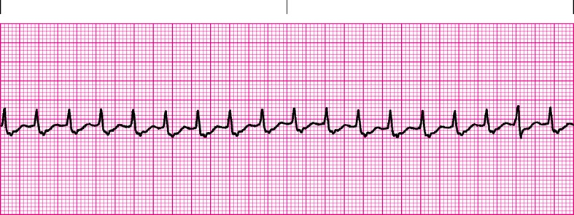
6.15

Slide 99
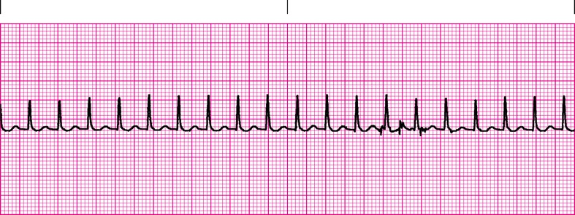
6.16

Slide 100
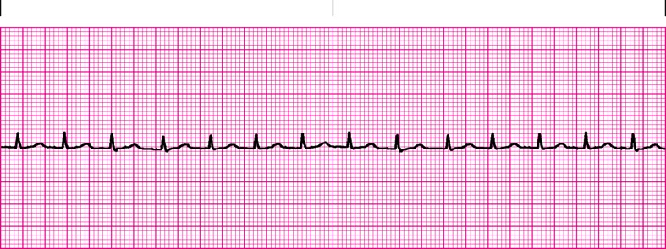
6.17

Slide 101
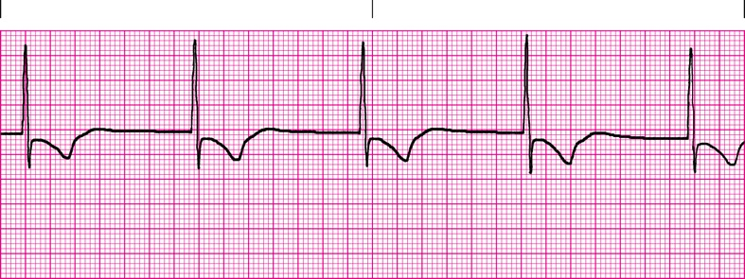
6.18

Slide 102
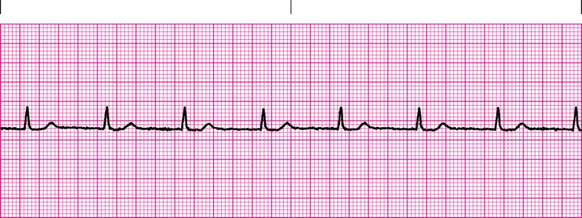
6.19

Slide 103
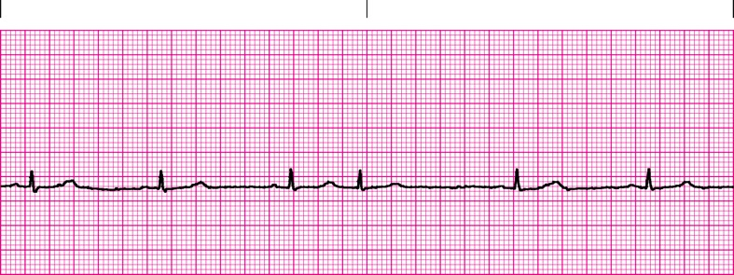
6.20

Slide 104
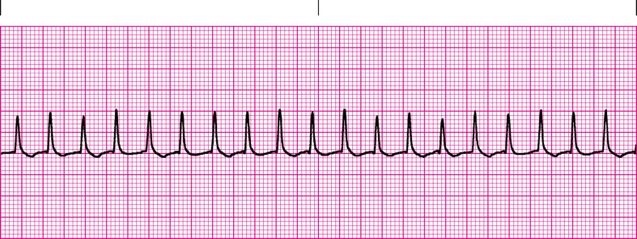
6.21

Slide 105
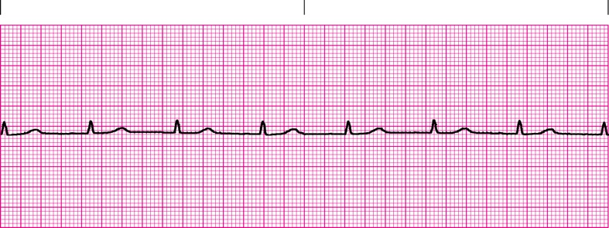
6.22

Slide 106
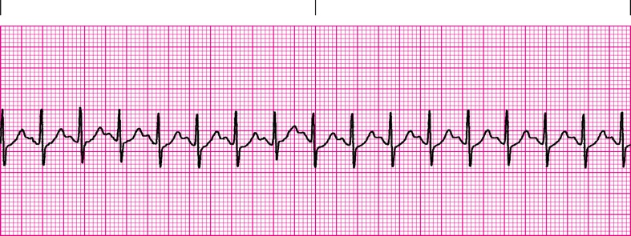
6.23

Slide 107
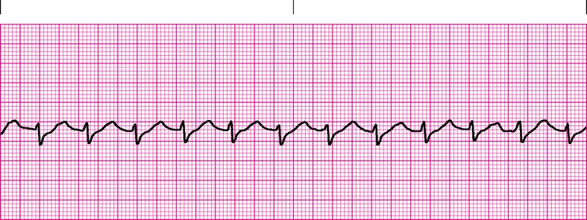
6.24

Slide 108
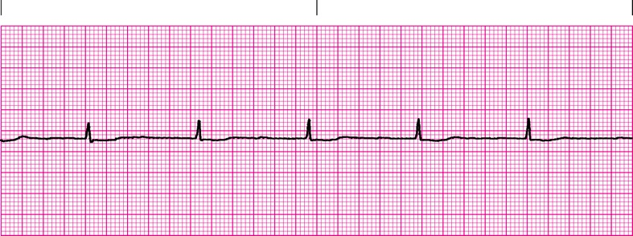
6.25

Slide 109
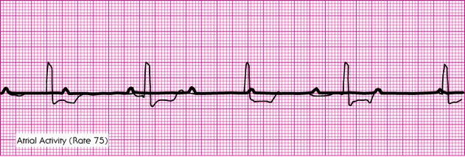
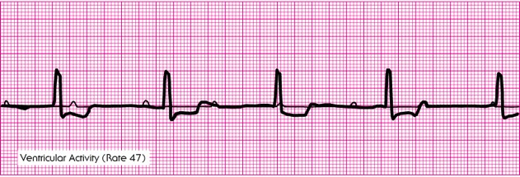
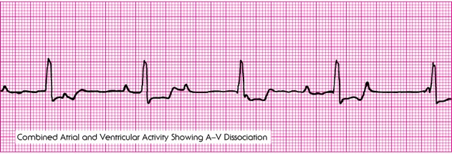

Slide 110
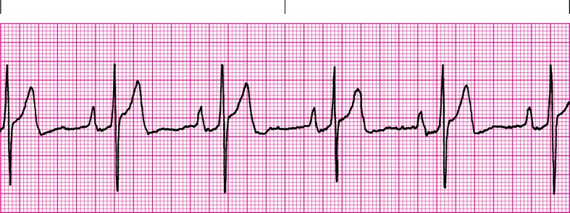
7.1

Slide 111
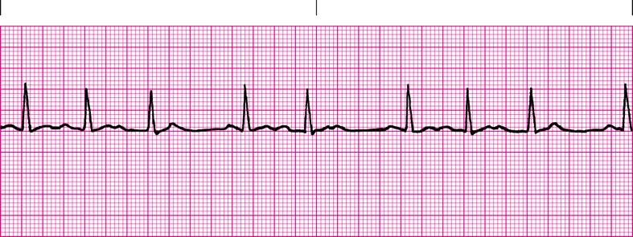
7.2

Slide 112
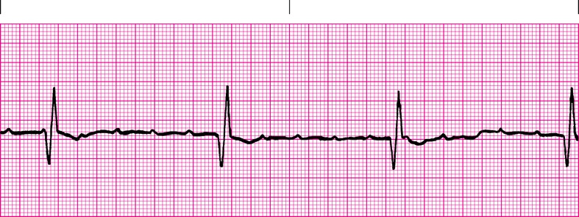
7.3

Slide 113
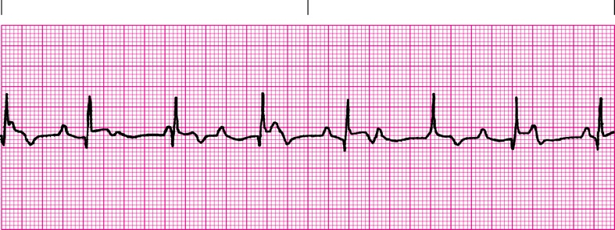
7.4

Slide 114
7.5

Slide 115
7.6

Slide 116
7.7

Slide 117
7.8

Slide 118
7.9

Slide 119
7.10

Slide 120
7.12

Slide 121
7.14

Slide 122
8.1

Slide 123
8.2

Slide 124
8.6

Slide 125
8.9

Slide 126
8.10

Slide 127
8.11

Slide 128
8.15

Slide 129
8.18

Slide 130
8.21

Slide 131
8.22

Slide 132
8.23

Slide 133
8.24

Slide 134
8.25

Slide 135
8.26

Slide 136
8.27

Slide 137
8.28

Slide 138
8.29

Slide 139
8.31

Slide 140
8.33

Slide 141
8.34

Slide 142
8.35

Slide 143
8.36

Slide 144
8.37

Slide 145
8.39

Slide 146
8.40

Slide 147
8.42

Slide 148
8.43

Slide 149
8.44

Slide 150
8.45

Slide 151
8.46

Slide 152
8.47

Slide 153
8.48

Slide 154
8.49

Slide 155
8.50

Slide 156
8.51

Slide 157
8.52

Slide 158
8.53

Slide 159
8.55

Slide 160
8.57

Slide 161
8.60

Slide 162
8.62

Slide 163
8.63

Slide 164
8.66

Slide 165
8.67

Slide 166
8.68

Slide 167
8.69

Slide 168
8.72

Slide 169
8.73

Slide 170
Questions.

Slide 171
Jim Cole, LP, MA, NRP, FP-C, CEMSO, CMTE
EMS and Emergency Management Coordinator
PeaceHealth Oregon Network
jcole3@peacehealth.org
541-222-1794
www.peacehealth.org/ems

